Slide 1





The CLEAR Trial
A 2x2 factorial randomised open label trial to determine the clinical and cost-effectiveness of hypertonic saline (HTS 6%) and carbocisteine for airway clearance versus usual care over 52 weeks in bronchiectasis (BE)
Chief Investigator: Professor Stuart Elborn, Queen’s University Belfast
Lead Applicant Physiotherapist: Professor Judy Bradley, Queen’s University Belfast

Slide 2
Site Initiation Training Part 5: Drug Response Assessment - Clinical

Slide 3
Drug Response Assessment
In this section we will explain the:
Reason for a DRA in the CLEAR study
Documents provided for the DRA
Training to be able to conduct the DRA
Interpretation of the results
Appropriate documentation of the outcome
Competency assessment
Pre-reading of associated documents:
CLEAR Study: Drug Response Assessment Guideline with Proforma for 6% Hypertonic Saline
CLEAR Study: Drug Response Assessment Competency Document

Slide 4
Drug Response Assessment
To assess hyper responsiveness (an exaggerated response of the airways to the stimulus i.e. to HTS) leading to bronchoconstriction which could render the individual unsuitable for this study i.e. >15% drop in FEV₁
UNLIKELY

Slide 5
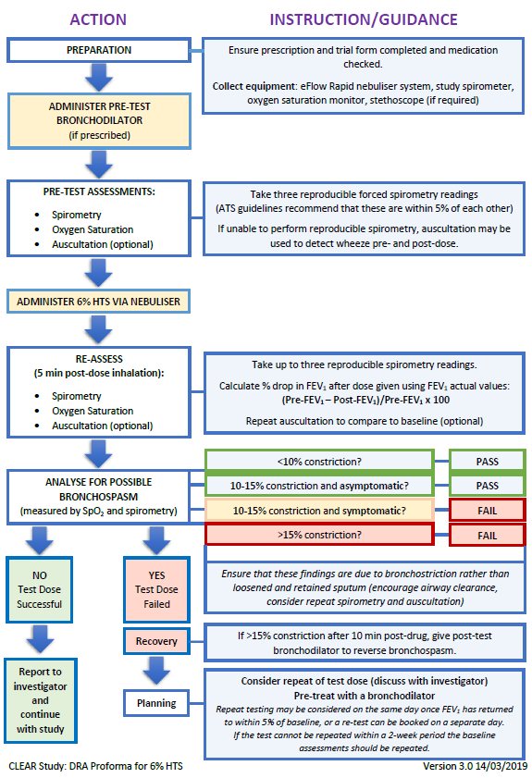
Drug Response Assessment

Slide 6
Step 1: Preparation
Drug Response Assessment
Obtain the DRA Proforma for 6% HTS
Collect and set-up the equipment:
  eFlow rapid nebuliser system and eTrack controller
  Study spirometer (SpiroSensePro)
  Oxygen saturation monitor
Collect the 6% HTS (4 ml ampoule)
Collect bronchodilator
Describe the DRA procedure
Give advice and education on nebuliser or dry powder inhaler (DPI) technique
Please remember to follow local guidelines on PPE/infection control when performing a DRA

Slide 7
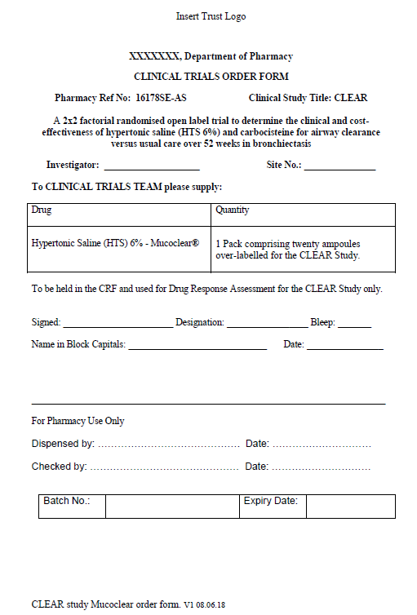
MucoClear 6% HTS Request Form
Drug Response Assessment
If in accordance with local processes, a 20-ampoule box of MucoClear HTS 6% may be released from pharmacy supplies and held by the clinical team for the DRA
An example pharmacy request form for MucoClear is available that may be adapted for local use

Slide 8
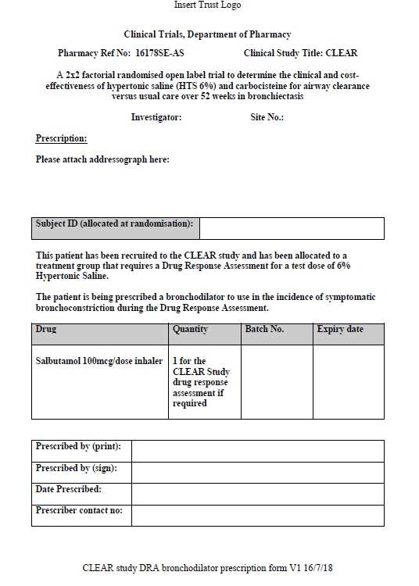
Bronchodilator Request Form
Drug Response Assessment
An example pharmacy request form is available for salbutamol that may be adapted for local use.

Slide 9

Step 2: Administer Pre-Test Bronchodilator (if required)
Drug Response Assessment
If the patient is routinely prescribed a short acting bronchodilator (e.g. 200 mcg salbutamol MDI) then they should also be asked to bring this with them to the baseline visit and they should take a pre-test dose 5-10 minutes before the baseline spirometry and HTS administration.
If the patient has not brought their routine bronchodilator to the visit then one should be prescribed to be taken 5-10 mins before the HTS administration.
If the patient is not usually prescribed a bronchodilator, then the HTS can be given without a pre-test bronchodilator.
However the research team must have access to a post-test bronchodilator i.e. Salbutamol 100 mcg, to use in the incidence of symptomatic bronchoconstriction (>15% drop in FEV1, or 10-15% with adverse symptoms).
Follow your local processes for access to a post-test bronchodilator. An example pharmacy prescription form is available that may be adapted locally.

Slide 10
Step 3: Pre-Trial Assessment
Drug Response Assessment
Check patient for clinical stability
  Feeling more unwell
  Haemoptysis
  Increase in steroid medication or
  Any recent contraindications to spirometry (e.g. chest pain, sinus surgery)
Complete FEV₁/FVC
  Best of 3 FEV₁ measurements recorded including % predicted
Advise patient if they feel nauseous, light headedness, tight in the chest or generally feel unwell when taking the nebuliser or DPI to tell you immediately

Slide 11
Step 4: Administration of the HTS
Drug Response Assessment
Monitor oxygen saturation and HR throughout procedure
Give the HTS 6% via the eFlow rapid nebuliser
If saturation falls below normal levels (for the patient) for a consistent period, reassess the patients breathing pattern. If this consistent low oxygen saturation persists, then the test should be stopped and a re-trial should be considered as per the DRA proforma and flow diagram
During the test and immediately post inhalation, ask the patient to describe any symptoms e.g. chest tightness
Stop immediately if the patient feels chest tightness, breathlessness or wheeze, lip or tingling in mouth or throat tightness, as this could be the sign of anaphylaxis
  If so inform the medical team for an immediate review
Repeat FEV₁/FVC measurements

Slide 12
Step 5: Analysis for Possible Bronchospasm
Drug Response Assessment
Once the reduction in FEV₁ has recovered to 10% or less from baseline and the patient is not symptomatic then the monitoring can be stopped
If the patients FEV₁ drop remains persistently above 10% from baseline, seek medical review for the patient and continue to monitor them closely
Any other scenario outside of those discussed above should be discussed with the PI for further guidance

Slide 13
Step 6: Review Results
Drug Response Assessment
Calculate amount of constriction (if any):
Pre FEV₁ - Post FEV₁ X 100 = % Constriction
Pre FEV₁

Slide 14
Step 7: Review Results
Drug Response Assessment
If post inhalation of the HTS the FEV₁ has not reduced by more than 10% this is a PASS
If post inhalation of the HTS the FEV₁ has reduced by between 10-15% and the are no adverse symptoms associated (such as wheeze and irritable cough) then it is suitable for use and a PASS
If post inhalation of the HTS the FEV₁ has reduced by between 10-15% and there ARE adverse symptoms associated (such as wheeze and irritable cough) then this is a FAIL
If post inhalation of the HTS the FEV₁ has reduced by more than 15%, then this is a FAIL and the patient should be closely monitored for deterioration
  Repeat FEV₁ should be taken after 10 minutes and FEV1 change from baseline re-calculated.
  If 10 minutes after inhalation of the HTS the FEV₁ remains reduced more than 15%, the researcher should administer the post test bronchodilator prescribed and monitor the patient closely throughout and repeat the FEV₁ again after a further 10 minutes

Slide 15
Step 8: Re-Assess if Required
Drug Response Assessment
Consider if test dose to be repeated (discuss with the investigator)
Consider if repeat test requires pre-treatment with a bronchodilator
  If a bronchodilator is required to enable a patient to pass a re-test the patient should be prescribed salbutamol 100 mcg, 2 puffs prior to each HTS administration during the study treatment period.
Repeat testing can be considered on the same day (discuss with the investigator) once FEV₁ has returned to within 5% of baseline, or a repeat test can be booked on a separate day. If the test is not within a 2-week timeframe baseline assessment should be repeated.

Slide 16
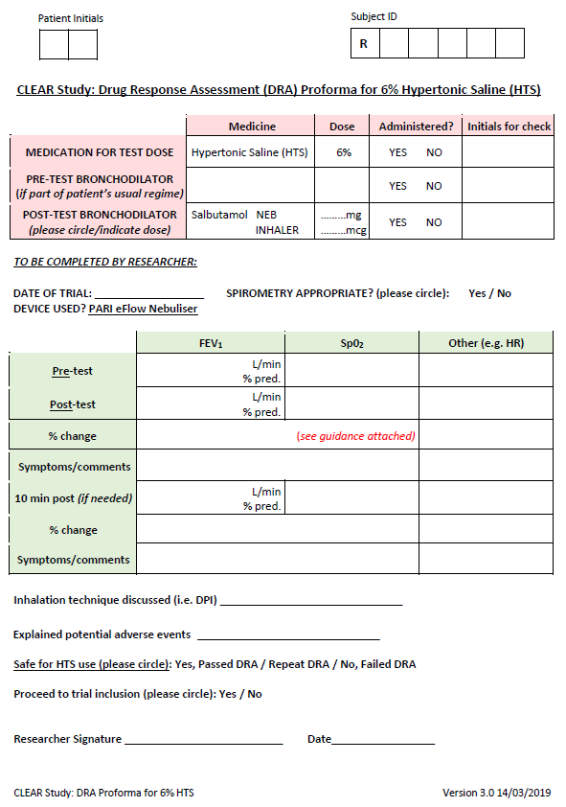

Step 9: Document Outcome of DRA
Drug Response Assessment
After the DRA is completed and the result confirmed, this should be recorded on the DRA form. All discussions should be documented clearly on the DRA Form
Complete the relevant part of the CRF to indicate the outcome of the DRA

Slide 17

Examples of calculations
Calculate amount of constriction (if any):
Pre FEV₁ - Post FEV₁ X 100 = % Constriction
Pre FEV₁
Case Studies | Pre FEV1 L/min (FEV1% pred) | Post FEV1 L/min (FEV1 % pred)
Patient 1 | 2.0 (76%) | 1.95
Patient 2 | 4.2 (69%) | 3.6
Patient 3 | 4.2 (69%) | 3.6 (symptoms)
Patient 4 | 2.0 (76%) | 1.5

Slide 18
Patient 1 Answer
Drug Response Assessment
Calculate amount of constriction (if any):
2.0 – 1.95 L/min X 100 = 2.5% Constriction
2.0
Pass

Slide 19
Patient 2 - Answer
Drug Response Assessment
Calculate amount of constriction (if any):
4.2 – 3.6 L/min X 100 = % Constriction
4.2
0.6 L/min X 100 = 14.3 % Constriction plus no adverse symptoms 4.2
Pass

Slide 20
Patient 3 Answer
Drug Response Assessment
Calculate amount of constriction (if any):
4.2 – 3.6 L/min X 100 = % Constriction
4.2
0.6 L/min X 100 = 14.3 % Constriction, plus symptoms (e.g. wheeze, 4.2 irritable cough)
Fail

Slide 21
Patient 4 Answer
Drug Response Assessment
Calculate amount of constriction (if any):
2.0 – 1.5 L/min X 100 = 25% Constriction
2.0
Fail

Slide 22
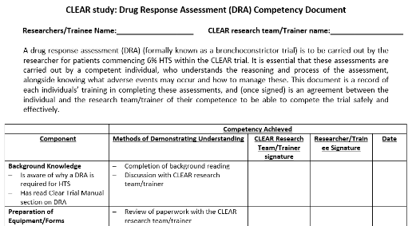
Drug Response Assessment
DRA Competency paperwork is required
  Completed separately with Prof Bradley in a 10-15 minute telecon

Slide 23
FAQ
A patient is prescribed a bronchodilator but does not regularly use it. Should the patient take his/her bronchodilator before HTS administration during the DRA?
If the patient is not supposed to use their bronchodilator regularly then the HTS can be administered without a pre-test bronchodilator. You may need to check with the clinical team whether they should be using their bronchodilator. Ensure you have a bronchodilator during the test to use in the incidence of symptomatic bronchoconstriction and follow the DRA Guideline

