Slide 1





The CLEAR Trial
A 2x2 factorial randomised open label trial to determine the clinical and cost-effectiveness of hypertonic saline (HTS 6%) and carbocisteine for airway clearance versus usual care over 52 weeks in bronchiectasis (BE)
Chief Investigator: Professor Stuart Elborn, Queen’s University Belfast
Lead Applicant Physiotherapist: Professor Judy Bradley, Queen’s University Belfast

Slide 2
Site Initiation Training Part 3:
Visits and Assessments - Clinical
  Study Visits
  Patient Study Pack
  Schedule of Assessments
  Screening and Recruitment
  Informed Consent
  Co- Enrolment
  Study Assessments and Questionnaires
  Treatment Allocation
  IMP dispensing and accountability
  Drug Response Assessment
  Airway Clearance Record/ Action Plan
  Visit 5/ Return of Equipment and Medication

Slide 3

Study Visits
Due to the COVID-19 pandemic this study is using remote visits where possible. This will continue for the remainder of the study.
The baseline visit must be delivered at site. We also strongly recommend that visit 2 is completed at site.
  All remaining visits can be delivered remotely*.
    The patient will be provided with a study pack at the baseline visit to take home. This will enable them to complete the study visits remotely.
For patients who need more support with study equipment, further visits as deemed necessary should be delivered at site.
Follow your local COVID-19 policies and procedures for visits delivered at site (to include PPE and pre-visit checks in relation to symptoms/reasons for self-isolation)
*If participating in the EME sub-study sputum sample is collected at baseline, visit 2 and visit 3 and therefore will require site visits

Slide 4
Patient Study Pack
You will be provided with a patient study pack, this will contain a folder divided into visits and will include the following:
Study Contact Card
Patient Tasks Summary Sheet
Patient Quickguide my SpiroSense
Patient Quickguide eflow (If applicable)
Questionnaires (for visits 2-5) (in the order they are to be completed): (QoL-B; SGRQ; EQ-5D-5L; Treatment Satisfaction Questionnaires for HTS and/or Carbocisteine (if applicable)) If allocated to both HTS and Carbocisteine alert the patient to the label stating which drug the questionnaire is relating to. They should complete the questionnaire for HTS first.
  Health Service Use Logs (for visits 1-4)
Airway Clearance Record/Action Plan (for all patients visits 1-5)
eFlow/mySpiroSense Utility Questionnaire (for visit 5 only)
Copy of informed consent form
You will also provide the following equipment/consumables:
Study Equipment: PARI Equipment
Thermometer
Study Medication (if applicable)

Slide 5
Schedule of Assessments
Visit Number | 1 | 2 | 3 | 4 | 5
Visit Schedule | Baseline | Week 2 | Week 8 | Week 26 | Week 52
Visit Window |  | +/- 3 days | +/- 7 days | +/- 14 days | +/- 14 days
Assessments
Inclusion & Exclusion Criteria Review | x
Informed consent | x
Demographics | x
Patient BE Characteristics | x
Assess Sputum colour from sample, if available | x
Patient Standard Care Review | x
Medical History | x
Review Medications | x | x | x | x | x
Vital Signs | x | x | x | x | x
Urine Pregnancy Test | x
Physical Exam | x
Confirmation of Eligibility | x
Adverse Events | <------------------------------------------------>
Respiratory and Systemic Symptoms Questionnaire (RSSQ) | x | x | x | x | x
Exacerbation/Antibiotic Use^ |  | x | x | x | x

Slide 6
Schedule of Assessments
Visit Number | 1 | 2 | 3 | 4 | 5
Patient Questionnaires
Treatment Satisfaction Questionnaire |  | x | x | x | x
QoL-B | x | x | x | x | x
SGRQ | x | x | x | x | x
EQ-5D-5L | x | x | x | x | x
Health Service Use Questionnaire | x | x | x | x | x
Lung Function Tests | x | x | x | x | x
Randomisation & Treatment Allocation | x
IMP prescribing & Dispensing | x |  | x | x
Drug response assessment (for patients assigned any HTS group) | x
Airway Clearance Record/Action Plan | x | x | x | x
Patient Training on Usual care, spirometers and eFlow | x | x | x | x
eFlow/mySpirosense Utility Questionnaire |  |  |  |  | x
Sputum Sample Collection (EME sub study only) | x | x | x
Spirometry (at home)# | <----------------------------------------------------------------------------------------->
Exacerbation Management^ | <----------------------------------------------------------------------------------------->

Slide 7
Screening and Recruitment Log
Record all patients screened
Unique Screening ID for each patient is assigned sequentially: format of SXXNNNN
  Prefix S denotes screening
  XX will be your site number
  NNNN will be allocated sequentially to each patient screened starting at 0001 e.g. at Site 01 the first patient screened would have Screening ID S010001
Record Patient Name, Hospital Number, DOB and Screening Date
  This log will remain at site and should not be sent onto NICTU as it contains patient identifiers
Record if patient is eligible for the trial. There is a key provided listing ‘reasons for non-eligibility’
For patients given a SWAT recruitment pack, record the unique Pack Identifying Number
Patients who decide to participate will be invited for a baseline visit

Slide 8
Screening and Recruitment Log
Record if patient randomised. There is a key provided listing ‘reasons for non-randomisation’
Record date randomised and Subject ID (assigned by Sealed Envelopes): format of RSSNNN
  Prefix R denotes randomisation
  SS will be your site number
  NNN will be allocated sequentially to each patient recruited at your site starting at 001 e.g. At Site 01 the first patient recruited would have Subject ID R01001
Retain Screening & Recruitment Log
Input screening data onto Web-based MACRO Screening database by the 1st Monday of each month. This allows the Trial Management Group to review at the monthly meeting
Bi-weekly telephone calls with the NICTU coordinator to discuss screening and recruitment, exacerbations, and other FAQs until your site is established

Slide 9
Screening and Recruitment Log
 |  | Site No: | S61 | PI Name: | Dr Joe Bloggs |  |  | Site Name: | Example Hospital NHS Trust
Screening ID | Patient Name | DOB | Hospital Number | Screening Date | Eligible for Trial? | If no, please select main reason for non-eligibility: | Other Reason: | SWAT Recruitment Pack Identifying Number | Randomised (y/n) | If no, please select main reason for non-randomisation: | Other Reason: | Date Randomised | Subject ID | Additional Comments
S610001
S610002
S610003
S610004
S610005
S610006
S610007
S610008
S610009
S610010
S610011
S610012
S610013
S610014
S610015
S610016
S610017
An electronic Screening Log (Excel spreadsheet) will be sent to your site

Slide 10
Informed Consent
Must be obtained from the patient prior to conducting any trial specific procedures
The informed consent form (ICF) must be signed and dated by the patient and the study staff taking consent
Original ICF:
  To be retained in the Investigator Site File
Copy of Information Sheet & ICF:
  To be filed in the patient’s medical notes
  To be given to patient
GP Letter to be sent for enrolled patients

Slide 11
Co-Enrollment
Sites selected are recruiting to Bronch-UK or EMBARC
Patients that are not enrolled on either Bronch-UK or EMBARC will be offered the chance to enrol on these studies

Slide 12
BE Characteristics (Baseline)
Diagnosis Details
Radiological Severity
Exacerbation and Antibiotic History
mMRC Breathlessness Score
Sputum Colonisation Details
Patients will be asked if they currently use Airway Clearance Techniques for their BE
  If yes, record description, start date, frequency and duration

Slide 13
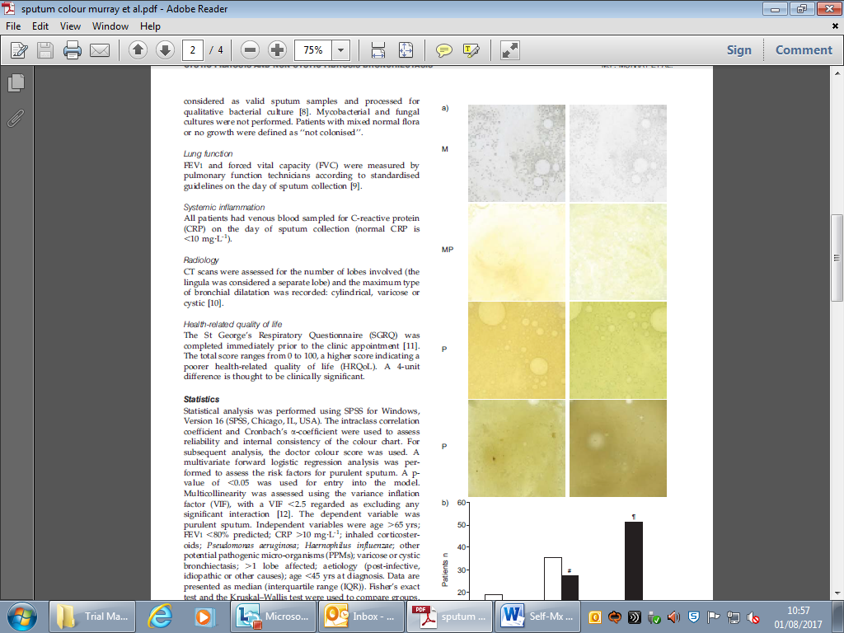
Sputum Colour
During the baseline visit the patient will be asked to collect sputum in a container*
If the participant can produce a sample, site staff should use the Sputum Colour Chart to colour grade the sputum into one of three categories:
If the patient is unable to produce a sample at the visit, they will be shown the sputum colour chart and asked to compare the usual colour of their sputum (over the last 14 days) to the photographs and indicate the closest colour to theirs
Document if the sputum colour was assessed by site staff or patient reported
Colour | Key
Mucoid (Clear) | M
Mucopurulent (Pale yellow, green) | MP
Purulent (Dark yellow, dark green) | P
*Discard sample if patient is not participating in the EME sub-study. For patients participating in the EME sub-study please see following slides.

Slide 14
Sputum Sample*
(*EME sub-study only)
ONLY APPLIES FOR THOSE SITES PARTICIPATING IN EME
If the patient is participating in the EME sub-study sputum will be collected at 3 time-points:
  Baseline (following consent)
  Visit 2 (weeks 2)
  Visit 3 (week8)
Collect the sample in the containers provided. These are pre-labelled with a unique sample number.
  Ask the patient to rinse their mouth with water prior to providing a sample especially if they have been drinking or eating recently. This is to prevent contamination of the sample.
  The sample can be collected throughout the visit if needed in order to fill the 60ml collection pot as much as possible (maximum of 1 x collection pot per visit is required)
  Complete the Sample Tracking Log for each sample.
  Store at -80ºC at the time sample is taken.
  Sites should maintain regular temperature control logs & have emergency management plans in the event of freezer failure.
Samples will be collected by courier for return to Belfast (after 5-6 sample boxes are filled).
All samples to be sent frozen, on dry ice and with no patient identifiable data.
Refer to Sample Handling Guideline for further details.

Slide 15
Sputum Sample Tracking Log*
(*EME sub-study only)
ONLY APPLIES FOR THOSE SITES PARTICIPATING IN EME

Slide 16
SWAT C
Sites will be provided with envelopes labelled with a unique number that corresponds to the Subject ID assigned to randomised patients by the automated randomisation system
Within each envelope there will be instructions on what should be provided to the patient at the end of each study visit and what code to record in the Case Report Form (CRF):
  Generic printed thank you card – Code 01
  Personalised wet ink signed thank you card – Code 02
  No thank you card – Code 03
If a site is not participating the SWAT they should record N/A in the patient’s CRF
Sites will initially receive enough envelopes for your agreed patient target, please contact NICTU when you need more
If visit is performed remotely, thank you cards (for code 01 & 02) can be posted out to patients along with their new questionnaires etc.

Slide 17
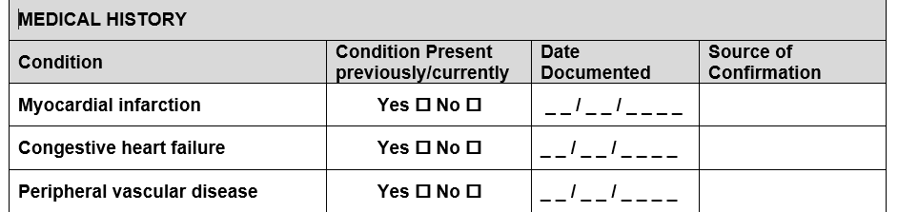
Medical History (Baseline)
Will also be used to score the patient’s Charlson Comorbidity Index and Bronchiectasis Aetiology and Co-Morbidity Index therefore specific form for data collection.
Tick ‘yes’ next to each condition that the patient has in their past and/or current medical history.
If yes, complete the ‘date documented’ and ‘source of confirmation’ i.e. any date and location (e.g. GP letter, clinic letter) that the condition has been documented in the patient’s medical history. It does not have to be the date of diagnosis/first date documented.
If patient reported and no documentary evidence enter ‘patient reported’ as the source of confirmation and date of the study visit as the date documented.
Do not leave any conditions blank i.e. you must indicate ‘yes’ or ‘no’ for all conditions.

Slide 18
Medications
Record any medications taken in the past 3 months (including current medications) in the concomitant medication form
  Any medications i.e. chronic medications ongoing at the baseline visit should not have a stop date
  If the start date of a long-term medication ongoing at baseline is unknown, please record a date three months prior to the visit date
Medications should be reviewed at each study visit (until visit 5)
  Any new medications should be added to the concomitant medication form
  The form should be updated with any changes i.e. if a medication is stopped or dose changed
  Any antibiotics/treatments taken for an exacerbation should also be included
  Any cyclical medication should be included, even if they are on their break, e.g. seasonal macrolides

Slide 19
Assessments
Vital Signs (onsite visits)
  Height (at baseline only), Weight, temperature
  Blood pressure, pulse, respiratory rate and SP0₂
Urine Pregnancy Test (at baseline only on women of child bearing potential)
Review Adverse Events (at every visit)
Vital Signs (at remote visits)
  temperature only. Ask patient to take their temperature using the thermometer provided at baseline

Slide 20
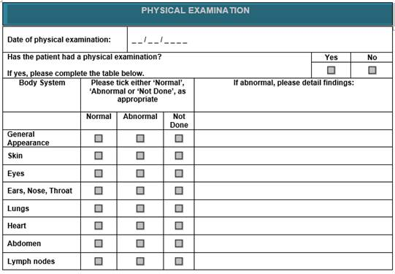
Physical Exam
Physical Examination (to be completed by PI or delegated physician) at Baseline (Visit 1)

Slide 21
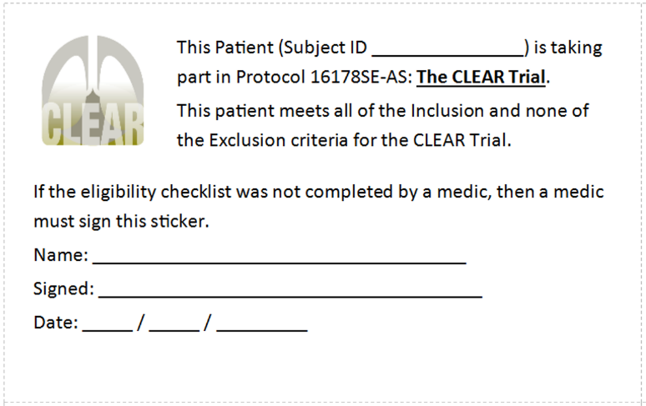
Confirmation of Eligibility
  Confirmation of patient eligibility based on inclusion & exclusion criteria must be done by a medically qualified physician
  Should be delegated this responsibility on the Delegation Log
  Confirmation of Eligibility must be documented prior to randomisation:
    Eligibility checklists to be completed for each patient
    Eligibility must also be documented in patient medical notes
If checklist is not completed by a physician, then ‘This patient meets all of the inclusion and none of the exclusion criteria for the CLEAR trial’ must be documented in the patient medical notes (stickers provided)

Slide 22
Outcome Questionnaires
(QOL-B, SGRQ, EQ-5D-5L)
At baseline, the QoL-B, SGRQ, EQ-5D-5L questionnaires are completed at the visit prior to randomisation.
To maintain independent completion at subsequent visits (Visit 2-5) the questionnaires will be completed by the patient at home prior to the visit (remote or site visit). Send patients a reminder to complete the questionnaires prior to visits 2-5.
The patient will be provided with a study pack at the baseline visit to take home containing the questionnaires for subsequent visits in the order they should be completed.
At the beginning of the visit (remote or site visit), firstly ask them if they have completed the questionnaires, and if not instruct them to complete them independently prior to commencing the visit. If you are completing a remote visit the patient can then read out their answers over the phone.
If the patient asks for help in completing their questionnaires, do not provide an answer. It is appropriate to clarify a question but not to provide an answer.
Emphasise that all responses will be kept confidential.
If during a remote visit the patient does not have their questionnaires, go ahead with remote visit as you can read out the questionnaires over the phone, but ensure the patient is sent out a new pack for future visits.

Slide 23
Health Service Use
Questionnaire and Logs
Health Service Use Questionnaires will be completed at study visits 1-5.
The patient will be provided with a study pack at the baseline visit to take home containing the Health Service Use Logs.
On remote study visits, go through the Health Service Use Log with the patient over the phone. You should complete the Health Service Use Questionnaire based on the patients responses to the Health Service Use Log.
Ensure the patient has the correct contact number for the study team to report any symptoms of exacerbations.

Slide 24
Treatment Satisfaction
Questionnaire
The Treatment Satisfaction Questionnaire is administered at visits 2-5. This should be completed at the end of the remote visit if the patient is willing.
There are a few different options for completing the questionnaires with patients on remote visits:
Patient should complete these independently and you can ask for their answers
Go through each question with the patient and you can ask for their answers
Patients assigned to treatment groups HTS (6%) or carbocisteine will complete one questionnaire
Patients assigned to a combination of HTS (6%) and carbocisteine will complete 2 questionnaires (Complete the questionnaire for HTS first)
Ask the patient to retain the satisfaction questionnaire for collection later.

Slide 25
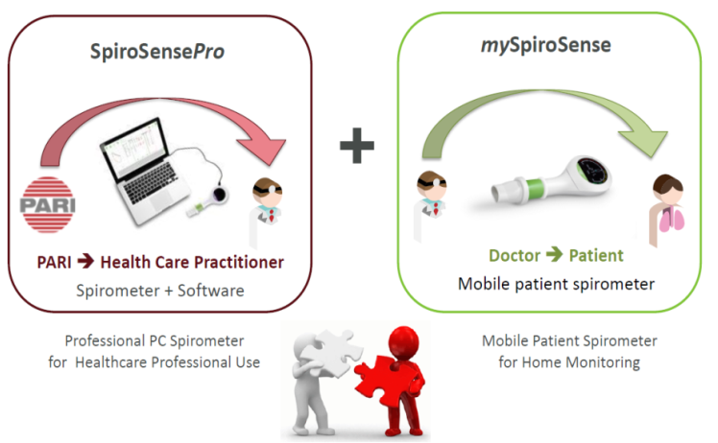
Lung Function Tests
Please see Separate PARI Training Slides which will cover SpiroSense device operation & software, cleaning and support
SpiroSense Pro self-calibrating spirometers
Use at baseline and all visits performed at site
Connect to study specific laptop/study computer
Single use mouthpieces (do not throw away the adaptor)
mySpiroSense
The patient should be instructed to perform home spirometry as per home spirometry guidelines.
Perform 3 readings around the same time of day after morning airway clearance if possible and relative to when they take their bronchodilators etc.:
  Weekly measurement
  Morning of study visits 2-5*
  At the beginning and end of an exacerbation
*if doing remote visits, only one set of mySpiroSense spirometry is required (done prior to the visit). Please check this has been done when completing the remote visit.
Results from the mySpiroSense device to be transferred via USB to the laptop at each onsite visit and at the end of the study
Spiromtery data (SpiroSense Pro and mySpiroSense) to be transferred to the PARI online portal periodically (every 6 months). Instructions will be provided to your site.

Slide 26
Treatment Allocation
1:1:1:1 randomisation to each of 4 treatment groups
Stratified by site, patient antibiotic use in the past year due to exacerbation, and patient use of macrolides
Treatment allocation will be assigned by an automated randomisation system “Sealed Envelope”

Slide 27
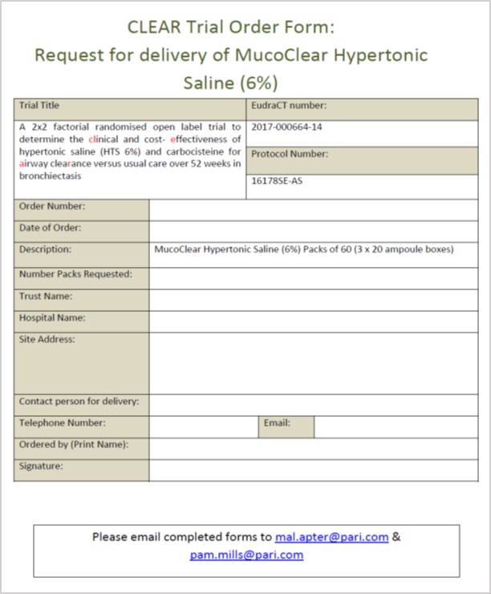
IMP Details
The following medicines are considered IMPs for the purposes of the CLEAR study:
  HTS (6%) – MucoClear
  Carbocisteine
Routine hospital stock of carbocisteine will be used
MucoClear will be ordered by pharmacy directly from PARI UK Limited using trial-specific order form

Slide 28
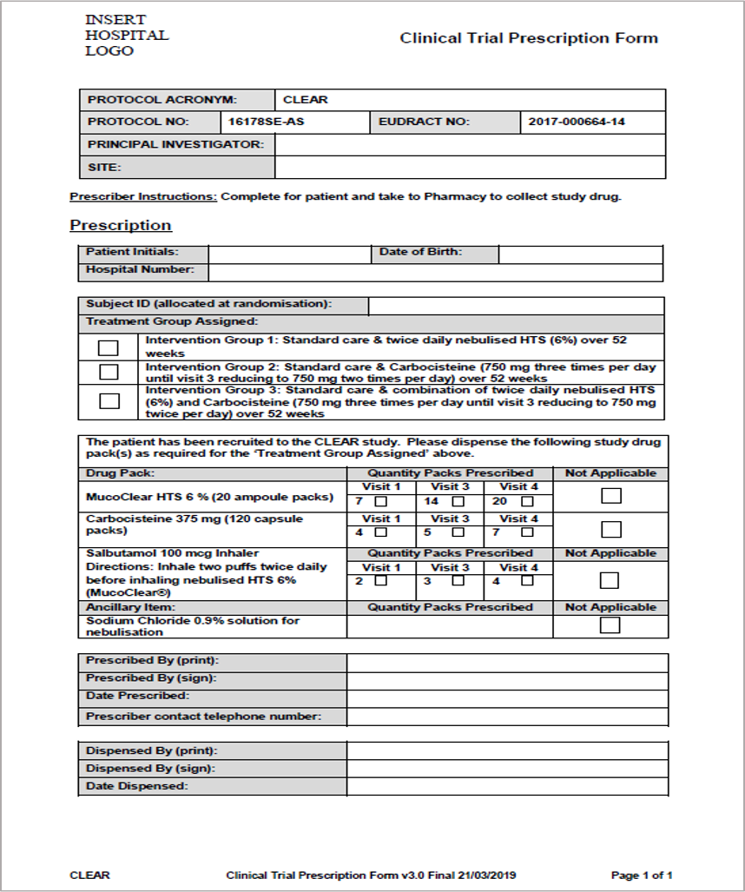
Clinical Trial Prescription

Slide 29
IMP Dispensing
Example label with information to be included on all drug packs dispensed for the CLEAR trial
Please ensure this information is included in your site’s IMP labels used for CLEAR.
We ask for a copy of the label to be used prior to issuing Sponsor green light.
At the baseline visit at site, 2 months of study drug is dispensed to patients
For patients who are more competent, there is the option for other visits to be delivered remotely. If visits are remote, the study drug should be dispensed as below (or as discussed during SIV) and collection/delivery arranged with the patient.
Study Drug | Baseline Visit | Visit 3 (Wk 8) | Visit 4 (Wk26)
Carbocisteine - packs of 120 capsules | 4 | 5 | 7
HTS (6%) - packs of 20 to be dispensed | 7 | 14 | 20

Slide 30
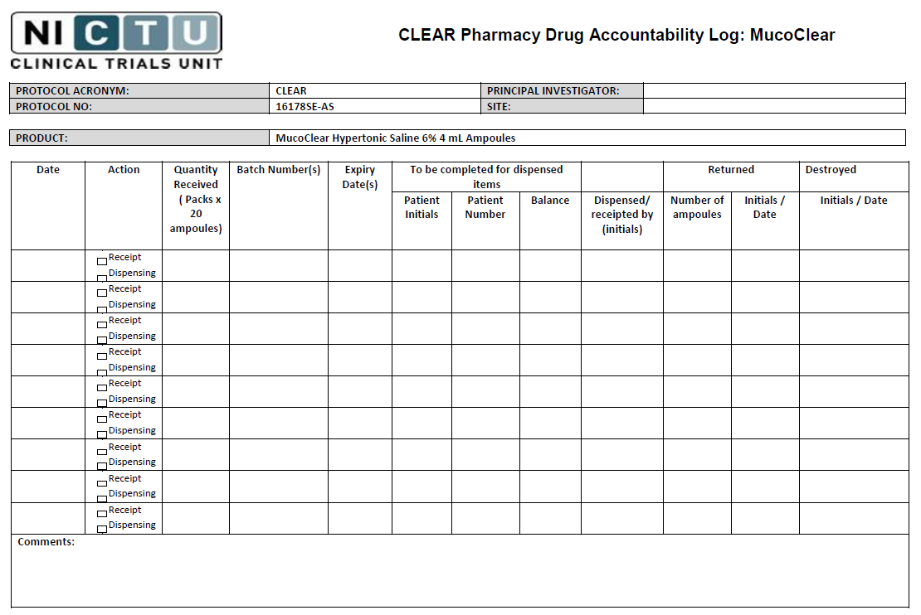
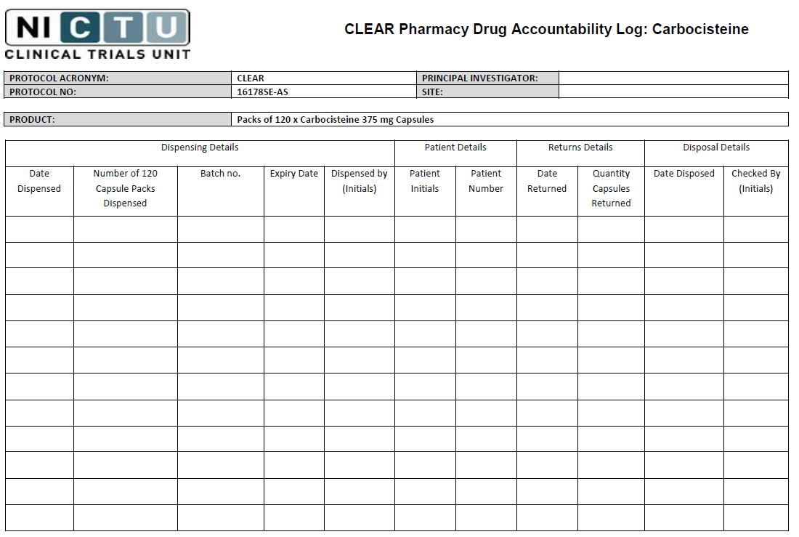
IMP Accountability - Pharmacy
For remote visits returns can be coordinated with pick ups/delivery, this should be agreed at SIV.
If patient is unable to attend IMP pick up, request that they count unused boxes & report at telephone visit.

Slide 31
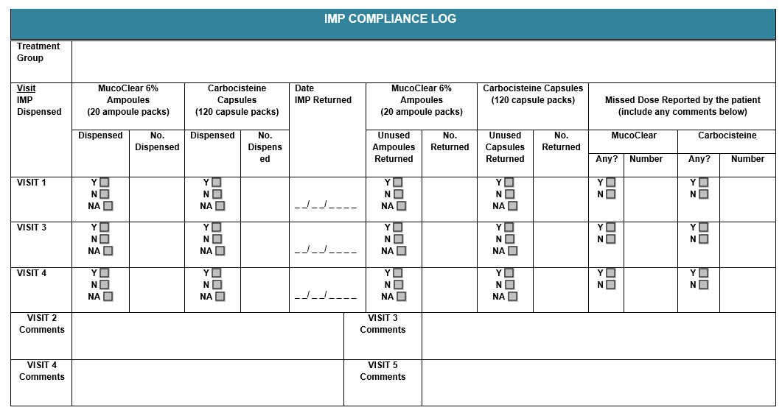
IMP Compliance Log
This will also be discussed at a local level in line with IMP delivery and collection for each site.

Slide 32
IMP compliance (dependant on patient arrangements)
Summary if remote visits:
Initial IMP dispensed at visit 1
If possible arrange a medication pick up at visit 3 (visit itself is still completed remotely)
Request that patient also brings unused medication and empty boxes/blister packs to visit 3 pick up for IMP accountability/compliance.
Repeat this for visit 4
If possible arrange a medication drop off at visit 5 (unused medication and empty boxes/blister packs)
If patient is not able to attend for medication pickup/drop off, a courier can be arranged.
In this case the number of unused medication can be counted by the patient & this recorded on IMP accountability log

Slide 33
Standard Care
All patients randomised to the trial will continue to receive Standard Care
If the patient currently does have any physical treatment/airway clearance techniques for their bronchiectasis:
Patients should continue their normal regime
Review what airway clearance techniques the patient is currently doing and record these on their Airway Clearance Record/Action Plan
Encourage the prescribed dose and optimal technique
For specific queries speak to the local clinical team
If a patient does not have a regular airway clearance regimen:
Encourage at least daily active cycle of breathing techniques (ACBT) and/or ask local advice
The ACPRC leaflet on ACBT can be provided to patients:
http://www.acprc.org.uk/Data/Publication_Downloads/GL-05ACBT.pdf
For further information on how to demonstrate ACBT to the patient see the video in the following link: scroll down to the video ‘Physiotherapy Techniques demonstration’
http://bronchiectasis.me/treatment/treatments/

Slide 34
Airway Clearance Record/
Action Plan
Used for all patients (all treatment groups)
It is a record of standard airway clearance and study medication(s) as applicable
Complete it with the patient and give it to them to take home and make a copy for their CRF
The Airway Clearance Record/Action Plan needs to be individualised for each patient
Review it at each study visit and update if required*
For patients in Intervention Groups 2 and 3 the Airway Clearance Record/Action Plan will need to be updated at Visit 3 due to the change in the dose of Carbocisteine
*During remote visits, complete it over the phone with the patient, and post a copy to the patient for reference

Slide 35
Airway Clearance Record/
Action Plan
Example: Intervention 1
Name of airway clearance treatment(s):
  Nebulised HTS and Active Cycle of Breathing Techniques
How I do/take my airway clearance treatment:
  I nebulise 1 x 4ml ampule of HTS using the eFlow nebuliser twice a day
  Immediately after nebulising my HTS I complete my airway clearance for 5 cycles or until my chest feels clear
When I do/take my airway clearance treatment:
  Immediately after nebulising my HTS I complete my airway clearance
I will remember to do/take my airway clearance treatment by:
  I set alarms on my phone to remind me when to take my airway clearance treatments
What to do if I miss a treatment:
  If I miss a treatment and remember later that day I will take it on the same day
  If I missed a treatment yesterday I will not take it, but will continue with my treatments today
What to do if my symptoms increase:
  If I am experiencing an increase in symptoms I will contact the research team

Slide 36
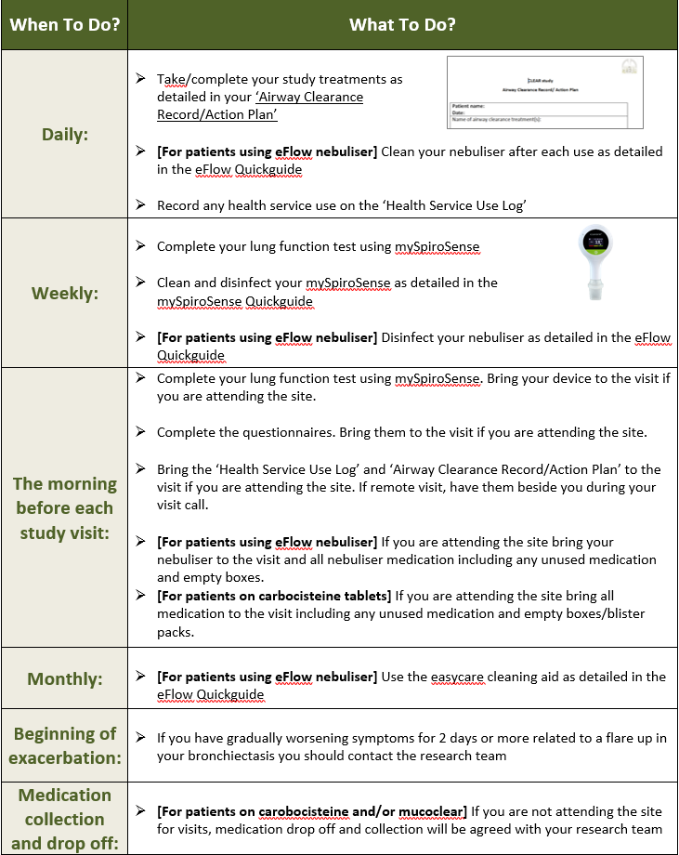
Patient tasks summary sheet

Slide 37
Eflow/mySpiroSense Utility Questionnaire (Visit 5)
At Visit 5, patients will be asked to complete a questionnaire about use of the mySpiroSense and eTrack Controller/eFlow Nebuliser (only for applicable groups).
You will be required to send these questionnaires to the NICTU in bulk.

Slide 38
Study Returns (Visit 5)
In addition to the assessments outlined for visit 5, arrangements will need to be made to return study medication (as discussed on earlier slides) and equipment after visit 5
Before returning the equipment advise patient to clean and disinfect the equipment in accordance with the ‘Patient Quickguide mySpiroSense’ and the ‘Patient Quickguide Eflow Rapid Nebuliser System & eTrack Controller’.
Advise patients to discard the mySpiroSense mouthpiece and the Eflow mouthpiece and aerosol head before returning. For the Eflow, only the connection cord and eTrack controller unit should be returned.
Options for returning the devices:
  Return at study visit if completed at site
  If remote visit a date/time should be agreed with the patient for drop off of equipment.
  If the patient is not happy to attend the site for drop off, a courier should be arranged to collect the equipment from the patients address.
*If the patient is continuing treatment with the eflow for one year after visit 5 you will still need to arrange to collect the eflow in order to download the data after visit 5, then return it to the patient for the follow up year and collect again after this year.

