Slide 1





The CLEAR Trial
A 2x2 factorial randomised open label trial to determine the clinical and cost-effectiveness of hypertonic saline (HTS 6%) and carbocisteine for airway clearance versus usual care over 52 weeks in bronchiectasis (BE)
Chief Investigator: Professor Stuart Elborn, Queen’s University Belfast
Lead Applicant Physiotherapist: Professor Judy Bradley, Queen’s University Belfast

Slide 2
Site Initiation Training Part 2:
Pharmacovigilance,
Monitoring and Documentation - CTU
  Pharmacovigilance
  Study Monitoring
  Source Documents
  Trial Committees
  NICTU SOP - Investigator Site File
  Archiving
  Study Document Completion
  Trial Supplies

Slide 3
Pharmacovigilance
Pharmacovigilance activities for CLEAR delegated to NICTU by Sponsor
NICTU SOP TM03 Recording & Reporting of Adverse Events, Serious Adverse Events & Urgent Safety Measures
SOP applies to PI and staff responsible for Adverse Event reporting
Documentation of SOP training required for all staff delegated AE/SAE reporting (Task 12) on the Delegation Log

Slide 4
Pharmacovigilance
Adverse Event (AE) Definition
  Any untoward medical occurrence in a patient or clinical trial subject administered a medicinal product and which does not necessarily have a causal relationship with this treatment
All observed & spontaneously reported AEs will be recorded
Signs & symptoms of exacerbations collected as outcomes will not be reported as AEs
However, if a patient experiences an exacerbation between the period of consent and randomisation this should be recorded and reported as an AE - e.g. during 4 week washout period
Patient will be asked about AEs at each visit
All AEs should be recorded in the patient’s medical notes and on the AE form in the CRF
CLEAR AE reporting begins upon consent & ends 30 days after the last administration of the study drug
PI or designee must assess all AEs for Severity, Seriousness & Causality

Slide 5
Assessment of AEs
Severity
Assessment of the intensity of the event:
  Mild (easily tolerated, causing minimal discomfort and not interfering with everyday activities)
  Moderate (sufficiently discomforting to interfere with normal everyday activities)
  Severe (prevents normal everyday activities)
  Life Threatening (life threatening consequences; urgent intervention indicated)
  Death (results in death)

Slide 6
Assessment of AEs
Seriousness
Assessment of whether an AE:
  Results in death:
    all deaths occurring from enrolment until 30 days of the last administration of the study agent must be treated as a SAE and reported as such
  Is life threatening
    an event in which the patient was at risk of death at the time of the event
  Requires hospitalisation or prolongation of existing hospitalisation
    an inpatient admission, regardless of length of stay or if overnight and even if a precautionary measure for continued observation
    hospitalisation (including for an elective procedure) for a pre-existing condition (prior to study entry) which has not worsened is not an SAE
  Results in persistent or significant disability or incapacity
  Consists of a congenital anomaly or birth defect
  Any other important medical event that carries a real risk of one of the outcomes above

Slide 7
Assessment of AEs
Causality
Assessment of the extent to which it is believed the AE may be related to the study drug:
  Not Related
    Temporal relationship of the onset of the event relative to administration of the product, is not reasonable or another cause by itself can explain the event
  Unlikely
    Temporal relationship of the onset of the event relative to administration of the product, is likely to have another cause which by itself can explain the event
  Possibly*
    Temporal relationship of the onset of the event relative to administration of the product, is reasonable but the event could have been due to another, equally likely cause
  Probably*
    Temporal relationship of the onset of the event relative to administration of the product, is reasonable and the event is more likely explained by the product than another cause
  Definitely*
    Temporal relationship of the onset of the event relative to administration of the product, is reasonable and there is no other cause to explain the event

Slide 8
Assessment of AEs
Expectedness
Where an event is assessed as possibly, probably or definitely related, the event is an Adverse Reaction (AR)
ARs are assessed as Expected or Unexpected based on the information in the Reference Safety Information:
  Expected: AR is consistent with the toxicity of the IMP listed in the RSI
  Unexpected: AR is not consistent with the toxicity of the IMP listed in the RSI
An AR may be ‘unexpected’ if it has occurred with a greater frequency or severity than expected
CLEAR Trial Reference Safety Information
  Carbocisteine (regardless of brand): Mucodyne Summary of Product Characteristics (Section 4.8 Undesirable effects)
  Hypertonic Saline 6%: MucoClear Patient leaflet (Side effects Section)

Slide 9
SAE Reporting
AEs assessed as meeting any of the criteria for seriousness require expedited reporting
Serious Adverse Events (SAEs) will be reported using the SAE form which must be submitted to CTU within 24 hours of becoming aware of the event.
The SAE Form should be emailed to the CTU: clinical.trials@nictu.hscni.net
Do not wait until all information about the event is available before notifying the CTU of the SAE
Any follow-up information not available at the time of the initial report should be submitted as it becomes available

Slide 10
SAE Reporting
Suspected Unexpected Serious Adverse Reactions (SUSARs) are SAEs that are considered to be related to the IMP and are unexpected i.e. their nature or severity is not consistent with the RSI
The CTU is responsible for reporting SUSARS to the Sponsor & Ethics Committee. Sponsor will report SUSARs to the MHRA as per regulatory requirements
A fatal or life threatening SUSAR must be reported within 7 days of the first knowledge of such an event (follow up info within 8 days)
All other SUSARS must be reported to REC and MHRA within 15 days if the first knowledge of such an event

Slide 11
Other Safety Reporting
Urgent Safety Measures
  If the PI or designee becomes aware of information that means that a change in a study procedure is necessary to protect a patient from an immediate hazard, they can implement this immediately without prior approval from REC or MHRA.
  The PI or designee should then immediately phone the clinical trials unit at the MHRA and discuss with a medical assessor
  They should also report the urgent safety measure to the CTU within 1 working day who will notify the sponsor
Pregnancy Reporting
  Pregnancy is not an AE or SAE but an abnormal outcome is, therefore, if applicable pregnancy information should be collected from enrolment until 30 days post the last administration of study drug
  In the event of a pregnancy the PI or designee should complete and submit the Pregnancy Reporting Form to the CTU by email within 14 days of being made aware of the pregnancy and follow-up until outcome.

Slide 12
Monitoring
To ensure:
  the rights, safety and well being of the trial participants are protected
  the reported trial data are accurate, complete and verifiable from source documents
  the trial is in compliance with the approved protocol, GCP and applicable regulatory requirements
First interim visit will occur within 6 months of the randomisation of the first patient
Further monitoring visits will take place annually thereafter, approximately every 12 months from the date of the first visit
A close-out visit will be arranged at each site once the final patient recruited at the site has completed all follow-up

Slide 13
Monitoring Visits
Visits will involve:
  Review of the Investigator Site File
  Review consent forms & check eligibility
  Review data entered into the MACRO clinical database and complete source data verification (SDV)
Please have all source documents available
Please ensure a team member is available to deal with queries
PI should be available at the end of the visit for a feedback meeting
Please be advised that due to the COVID-19 pandemic, remote monitoring visits may have to be arranged instead of an onsite visit.

Slide 14
Source Documents
PI agrees to provide access to source documents for trial-related monitoring or audits/inspections
Source documents for CLEAR
  Patient Medical Notes
  Source Workbooks
  Informed Consent Forms
  Prescriptions
  Spirometry Results PDF Files: Download/Printout
  Patient Questionnaires
The location of source data will be confirmed with each site, and recorded on a Source Data Location list.

Slide 15
Trial Committees
Trial Steering Committee
  Professor Andy Jones (Chair)
  Professor Graham Devereux
  Dr Rosina Ledermuller
  Professor Stuart Elborn
  Dr Una Jones
  Professor Barry Plant
  Professor Patrick Flume
  Mrs Fiona Copeland
  Professor Judy Bradley
  Dr Robert Rutherford
  Aidan Kearney
Data Monitoring and Ethics Committee
  Professor Stefano Aliberti (Chair)
  Dr Ian Bradbury
  Professor Scott Bell
Trial Management Group
  Professor Stuart Elborn
  Professor Judy Bradley
  Andrew Jackson
  Rachael McQuillan
  Olive McAleese
  Clare Adair
  Christina Campbell
  Sorcha Toase
  Ashley Agus
  Joanne Thompson
  Patricia Rafferty
  Margaret McFarland

Slide 16
Investigator Site File (ISF)
Trial Master File (TMF) holds all essential documents
Inspections or Audits of the TMF are used confirm compliance with regulatory requirements
The Investigator Site File (ISF) at each site is a key section of the TMF
NICTU has been delegated TMF set-up & maintenance by the Sponsor, therefore, the ISF must be set-up according to NICTU SOP TM02: ISF and Essential Documents
PI is ultimately responsible for the set up and maintenance of all essential documents in the ISF but may delegate (Task 17) to a member of the research team who has documented SOP training

Slide 17
Investigator Site File (ISF)
As each site is initiated an ISF will be provided to the PI
  Must be retained within a secure location with restricted access
  All documents should legible and accurate and signed and date as appropriate
  Contains all essential documents, logs and forms for trial
Maintained and a kept up to date on an on-going basis throughout the trial
  Previous versions of essential documents i.e. protocol should be marked as superseded
  All filing done in a timely manner and filed chronologically within each section
  Must be available for monitoring visits for audits
Once the trial is finished the PI is responsible for reviewing to ensure all essential documents are present
  Once close out activities completed the ISF can be archived

Slide 18
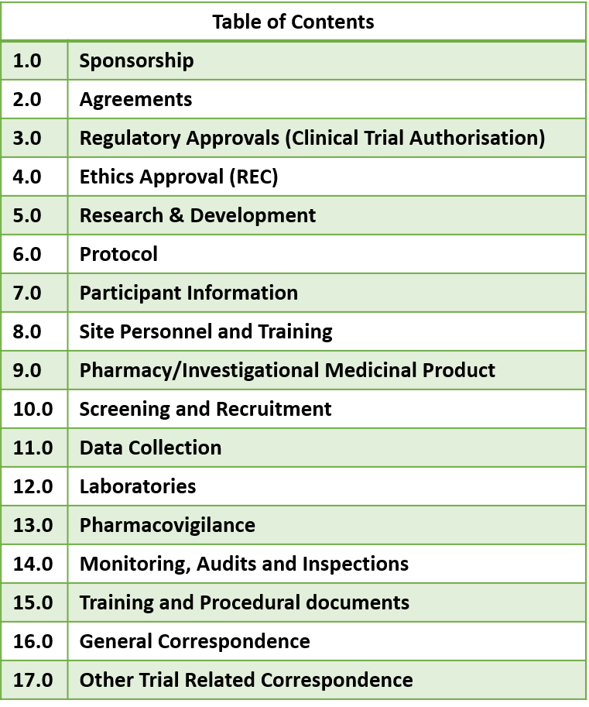
ISF Index
Index at the beginning of the file outlines the documents to be retained in the file and where these should be held
Intended as a guide. If a document is not applicable to the CLEAR trial this should be noted on the index
Where a document is applicable but is filed elsewhere a file note should be added to the applicable section e.g. pharmacy documents

Slide 19
Archiving
The PI is responsible for archiving essential documents at the study site
Unless otherwise directed ensure that all study records are archived appropriately on conclusion of the study and retained for 5 years
Patient medical files should be retained for 15 years

Slide 20
Study Document Completion
SWAT: Thank you letters
Study Logs
  Log for Protocol Training- All staff to go on Delegation Log (including Pharmacy staff)
  NICTU SOP Training Logs:
    AE/SAE reporting – All staff to be delegated Task 12 on Delegation Log
    ISF – All staff to be delegated Task 17 on Delegation Log
  Delegation Log
  PARI Training Log
  DRA Competency Document
CVs (copies of wet-ink signed and dated within 1 year) and GCP Certs - all staff to go on Delegation Log
Please Note: If a member of the team leaves the study, please ensure they sign off the delegation log & that the updated log is forwarded to CTU.
If you need copies of any trial documentation please contact the NICTU

