Slide 1





The CLEAR Trial
A 2x2 factorial randomised open label trial to determine the clinical and cost-effectiveness of hypertonic saline (HTS 6%) and carbocisteine for airway clearance versus usual care over 52 weeks in bronchiectasis (BE)
Chief Investigator: Professor Stuart Elborn, Queen’s University Belfast
Lead Applicant Physiotherapist: Professor Judy Bradley, Queen’s University Belfast

Slide 2
Site Initiation Training Part 6: Randomisation Process - CTU

Slide 3
Randomisation
Randomisation takes place at the baseline visit after all the baseline assessments, questionnaires and spirometry have been completed and confirmation of eligibility has been documented.

Slide 4
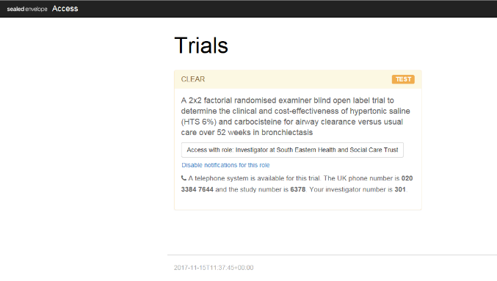
Sealed Envelopes Randomisation
After staff log in with their password and email address you will see this screen.
To enter the “Access with role: Investigator” button

Slide 5
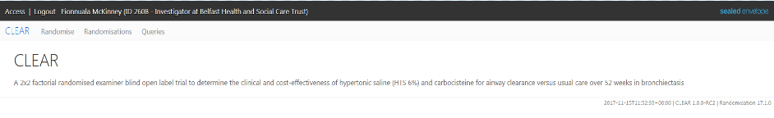
Sealed Envelopes Randomisation
This is the screen that you will see when you have accessed the system
From here you can select:
  Randomise – to randomise a patient to an intervention
  Randomisations – view a list of all randomised patients at your site & create a query about any patient randomised at your site
  Queries – view all open and closed queries raised at your site

Slide 6
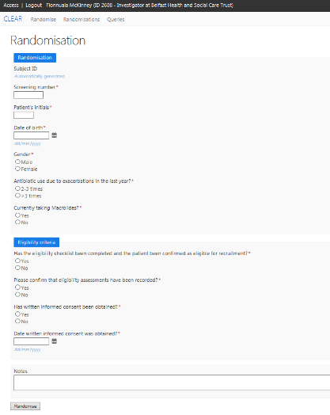

Sealed Envelopes Randomisation
This is the Randomise tab
Here you will enter the patients information
After you have entered in all the information you will be asked to enter your e-signature (password) to sign off the investigators declaration
If the patient is eligible an email will be sent to all site email accounts receiving notifications
Please note: If a patient takes seasonal Macrolides, but is currently in their seasonal break, please select “Yes” to “Currently taking Macrolides”

Slide 7
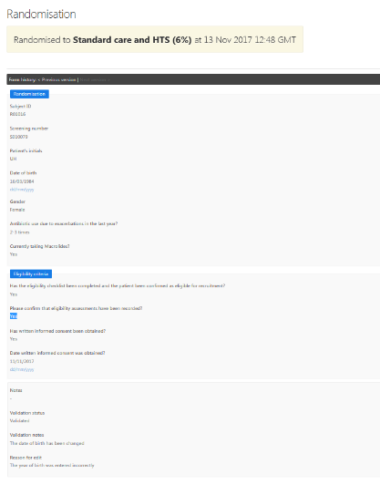
Sealed Envelopes Randomisation
If you click edit query you will see the information validated by the administrator
If necessary the investigator can take further action.

Slide 8
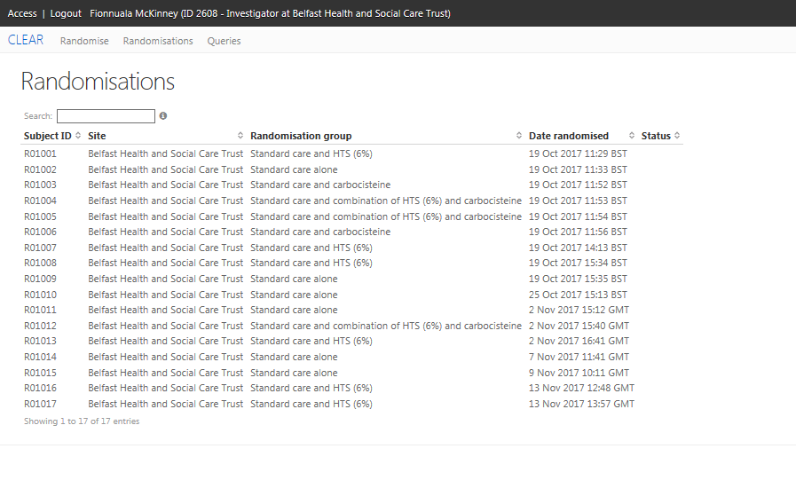
Sealed Envelopes Randomisation
View in the Randomisation tab
By selecting on a Subject ID you can raise a query for an administrator in the NICTU to action

