Slide 1




Mucoactives in Acute Respiratory failure: Carbocisteine and Hypertonic saline (MARCH)

Slide 2

Agenda: Site Initiation Visit Training
Part 1: MARCH Study Overview
Background and Trial Design; SWAT, Sample Study; Sites; Recruitment Targets
Part 2: Mucoactive Management and Pharmacovigilance
Part 3: Local Trial Management (ex. Pharmacy Staff)
Patient Pathway and Screening Logs; Informed Consent; Randomisation System; Case Report Forms (eCRF); Study Withdrawal; Safety Outcome Reporting; Serious Breaches; Protocol Deviations; Monitoring; Sample Study; Training and Delegation Logs.
NB SIV Training covers Protocol Version 1.0 and Version 2.0

Slide 3
General
Introduction to trial team
Enter name, role, organisation in the chat function
Session recording
Please contact the trial team for dates and times of other sessions should other colleagues need to attend

Slide 4
Key Details
Main Contact
MARCH Trial Team
Northern Ireland Clinical Trials Unit (NICTU)
7 Lennoxvale, Malone Road, Belfast, BT9 5BY
Tel: +44 28 9615 1447
Email: MARCH@nictu.hscni.net
Funder: National Institute for Health Research HTA Programme (CI: Connolly)
Sponsor: Belfast Health and Social Care Trust
CI: Prof Danny McAuley
Co-CI: Dr Bronwen Connolly, b.connolly@qub.ac.uk, 028 9097 6047
Trial Manager: Dr Caroline Wilson
Trial Coordinator: Dr Naomi Dickson

Slide 5
Study Oversight and Support
Data Monitoring and Ethics Committee
Prof Julian Bion (Chair)
Dr Michelle Kho
Prof John Norrie
Trial Steering Committee
Prof Leanne Aitken
Prof James Chalmers (Chair)
Dr Bronwen Connolly (Co-CI)
Ms Chantal Davies (PPI)
Dr Abdel Douiri (Statistician)
Ms Rebecca Langley (PPI)
Prof Danny McAuley (CI)
Prof Alistair Nichol
Patient and Family Advisory Group
Goutam Das
Chantal Davies
Fransceso Palma
Gordon Stumey
Rebecca Langley
Barry Williams

Slide 6
Background and Trial Design

Slide 7
Invasive Mechanical Ventilation
Artificial airway
Removal of body’s own humidification system
Impaired mucociliary clearance
Altered secretion rheology
Risk of aspiration
Ventilator-associated infection
Pre-existing infection diagnosis
Secretion retention
MARCH Site Initiation Visit Slides V6.0 08/02/2022

Slide 8
Usual Airway Clearance Management
Key techniques
Key features
Suctioning
Humidification
Isotonic saline instillation
Respiratory physiotherapy techniques
May be supplemented by mucoactives
Patient-centred approach
Individualised assessment to determine clinical need
Tailored treatment
Evaluation using objective and subjective markers
Mucoactives typically commenced for thick, difficult to clear, secretions
MARCH Site Initiation Visit Slides V6.0 08/02/2022
Connolly et al, 2020, Physiotherapy, 108, 78-87

Slide 9
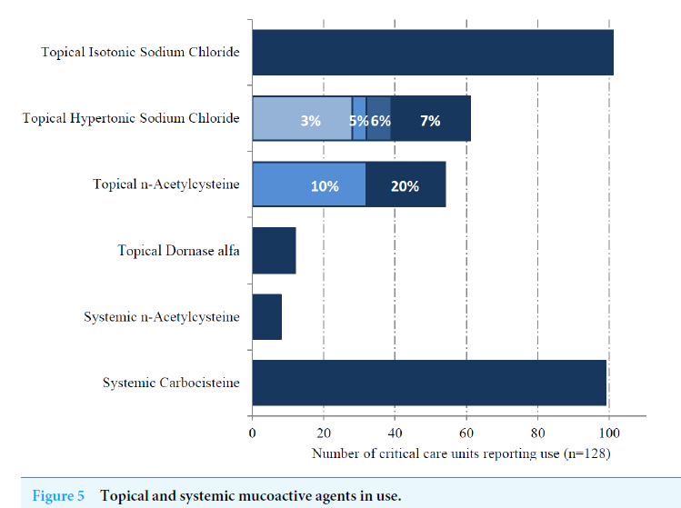
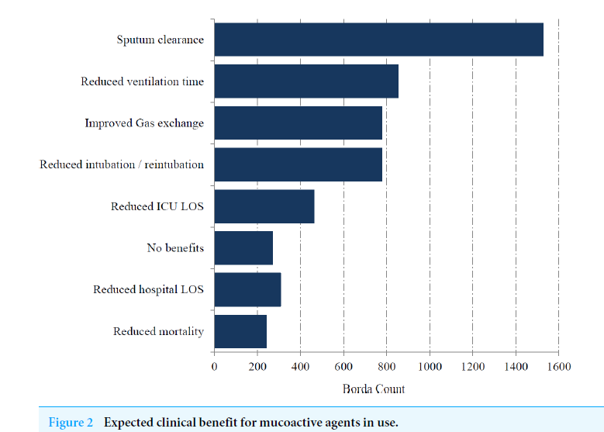
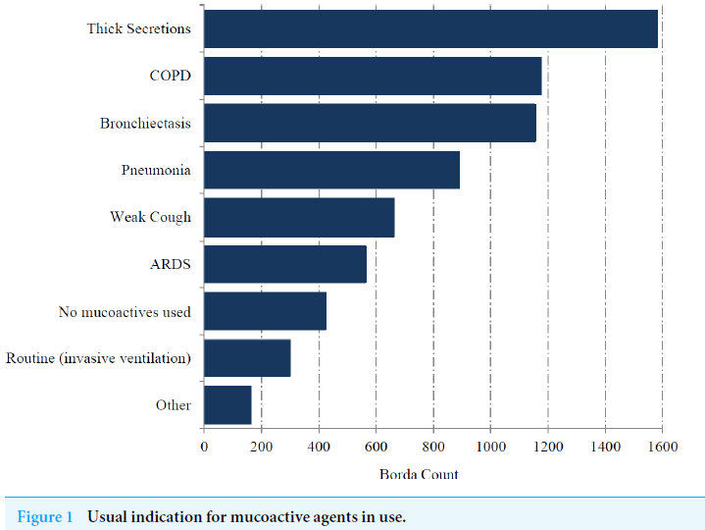
Use in Clinical Practice
Borthwick et al, 2020, Peer J, 8:e8828 https://peerj.com/articles/8828/
Notes:
mucoactive drugs are actively prescribed in 83% of ICUs, and at any given time, approximately 30% of patients receiving mechanical ventilation are prescribed at least one mucoactive drug.

Slide 10
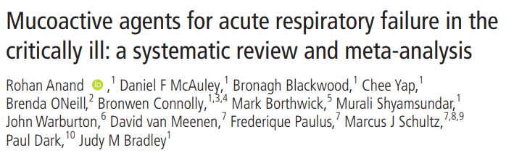
No effect on duration of mechanical ventilation, mortality, hospital stay, and ventilator-free days
Effect on reducing ICU length of stay
Varying quantities of data, often with high risk of bias and heterogeneity, and low certainty
Not all commonly used mucoactives had evidence to support or refute use e.g. carbocisteine; others had low quality evidence e.g. HTS
Anand et al, 2020, Thorax, 75, 623-631
Notes:
N-acetylcysteine was ineffective, there was inconsistent and low quality evidence for the use of hypertonic saline, and no evidence to support or refute the use of carbocisteine

Slide 11
Mucoactives
Empirical use, and minimal evidence of effectiveness
Wide variability in prescription practices across ICUs and clinicians
No national guidelines to inform clinical practice
Decision-making around use based on
  Local availability
  Personal preference
  Prior experience

Slide 12
Aim
To determine whether use of mucoactives in critically ill patients with acute respiratory failure improves outcomes and is cost effective compared to usual care

Slide 13



Overview
2x2 factorial RCT; open label, unblinded
1956 patients
40-50 UK ICUs

Slide 14
Trial Design
2x2 factorial RCT
Group 1
(n=489)
Group 2
(n=489)
Group 3
(n=489)
Group 4
(n=489)
Carbocisteine
Hypertonic saline
Carbocisteine and Hypertonic saline
No mucoactive
+
+
+
+
Usual airway clearance management; suctioning, heated humidification, respiratory physiotherapy +/- isotonic saline
Primary outcome: Duration of mechanical ventilation

Slide 15
Inclusion Criteria
Aged ≥16 years
An acute and potentially reversible cause of ARF as determined by the treating physician
Receiving invasive mechanical ventilation via endotracheal tube or tracheostomy
Anticipated to remain on invasive mechanical ventilation for at least 48 hours
Presence of secretions that are difficult to clear with usual airway clearance management (as assessed by the treating clinical team)

Slide 16
Exclusion Criteria (Protocol V1.0)
Pre-existing chronic respiratory condition receiving routine use of any mucoactive
Mucoactive treatment started more than 24 hours prior to trial enrolment
Known adverse reaction to either study mucoactive
Treatment withdrawal expected within 24 hours
Known pregnancy
Previous enrolment in the MARCH trial
Declined consent
Prisoners (deleted Protocol V2.0)
The treating clinician believes that participation in the trial would not be in the best interests of the patient

Slide 17
Exclusion Criteria (Protocol V2.0)
Pre-existing chronic respiratory condition receiving routine use of any mucoactive
Mucoactive treatment started more than 24 hours prior to trial enrolment
Known adverse reaction to either study mucoactive
Treatment withdrawal expected within 24 hours
Known pregnancy
Previous enrolment in the MARCH trial
Declined consent
The treating clinician believes that participation in the trial would not be in the best interests of the patient

Slide 18
COVID-19
COVID-19 not a specific exclusion criterion
All patients with suspected or confirmed COVID-19 meeting MARCH inclusion criteria can be considered for participation
  Enter onto screening log
  Eligibility based on local physician decision
    – if excluded note reason on screening log
  If randomised, excluded from the sample study (no blood or sputum samples)

Slide 19
Co-enrolment
Eligible for co-enrolment on discussion with trial team
CTU should be informed if co-enrolment is being considered
Case-by-case basis adopting national critical care approach
Details of co-enrolment with studies should be documented in the eCRF (MACRO)
Sites will be updated of any co-enrolment agreements

Slide 20
Study Interventions and Comparator
 | Study IMP | IMP administration
Intervention 1 | Carbocisteine (capsules or syrup) | 750 mg three times daily, for up to 28 days, delivered systemically, plus usual airway clearance management. NB Patients extubated on Day 27 or Day 28 will receive the study mucoactive until Day 29 or Day 30 respectively (until primary outcome achieved – see next slide).
Intervention 2 | Hypertonic saline (6 or 7% concentration) | 4 ml four times daily, for up to 28 days, delivered via nebulisation, plus usual airway clearance management. NB Patients extubated on Day 27 or Day 28 will receive the study mucoactive until Day 29 or Day 30 respectively (until primary outcome achieved – see next slide).
Intervention 3 | Carbocisteine and hypertonic saline | As described in intervention 1 and 2, plus usual airway clearance management.
Comparator | No mucoactive | Usual airway clearance management including suctioning, heated humidification, and respiratory physiotherapy; isotonic saline may also be used depending on clinical preference.

Slide 21
Study Interventions and Comparator
 | Study IMP | IMP administration
Intervention 1 | Carbocisteine (capsules or syrup) | 750 mg three times daily, for up to 28 days, delivered systemically, plus usual airway clearance management. NB Patients extubated on Day 27 or Day 28 will receive the study mucoactive until Day 29 or Day 30 respectively (until primary outcome achieved – see next slide).
Intervention 2 | Hypertonic saline (6 or 7% concentration) | 4 ml four times daily, for up to 28 days, delivered via nebulisation, plus usual airway clearance management. NB Patients extubated on Day 27 or Day 28 will receive the study mucoactive until Day 29 or Day 30 respectively (until primary outcome achieved – see next slide).
Intervention 3 | Carbocisteine and hypertonic saline | As described in intervention 1 and 2, plus usual airway clearance management.
Comparator | No mucoactive | Usual airway clearance management including suctioning, heated humidification, and respiratory physiotherapy; isotonic saline may also be used depending on clinical preference.
Importance of comparator group to MARCH
Non-use of mucoactives part of current UK practice
Avoid use of hypertonic saline and carbocisteine in comparator group
Use of non-study mucoactives recorded and monitored by CTU/ TMG.

Slide 22
Primary Outcome: duration of mechanical ventilation (hours)
Time from randomisation until first successful unassisted breathing (defined as maintaining unassisted breathing at 48 hours or death)
‘COVenT’ core outcomes for trials of interventions intended to modify the duration of mechanical ventilation
Blackwood et al, Critical Care Medicine 2019; 47(10): 1324-31
Notes:
There seems to be an empty footer at the top of this slide…it’s not noticeable in slide show

Slide 23
Primary Outcome: duration of mechanical ventilation (hours)
To clarify:
Unassisted breathing is defined as no inspiratory support or extracorporeal lung support
Success is defined as maintaining unassisted breathing at 48 hours
Duration includes time receiving extracorporeal lung support, invasive mechanical ventilation and non-invasive ventilation delivering volume or pressure support ventilation
Duration excludes time receiving high-flow oxygen therapy and continuous positive airway pressure
Patients with a tracheostomy in situ may still achieve successful unassisted breathing
Follow-up to 60 days from randomisation

Slide 24
Secondary Outcomes
In hospital
Outcome | Measurement tool, definition, method | Censorship
Extubation | Time from randomisation to first successful extubation (success defined as remaining free from endotracheal or tracheostomy tubes at 48 hours) | 60 days
Re-intubation | Event of reintubation of endotracheal tube after a planned extubation (censored at hospital discharge); excludes temporary reinsertion of endotracheal tube for procedures only. | 60 days
Respiratory physiotherapy input | Occurrence and frequency of airway clearance sessions | ICU discharge, death, or Day 28, whichever occurs first
Antibiotic usage | Dose of individual agents | ICU discharge, death, or Day 28, whichever occurs first

Slide 25
Secondary Outcomes
In hospital
Outcome | Measurement tool, definition, method | Censorship
Duration of ICU and hospital stay | Time from randomisation until patient first leaves the relevant facility or dies | 6 months
All-cause mortality | Confirmation and cause of death | 6 months
Safety | Clinically important upper gastrointestinal (GI) bleeding due to peptic ulceration confirmed on upper GI endoscopy Bronchoconstriction requiring nebulised bronchodilators Ventilator or circuit dysfunction with respiratory deterioration Hypoxaemia during nebulisation | Censored at ICU discharge, death, or Day 28 whichever occurs first.
Hospital resource use | Number of days at level of care 0/1/2/3 | 6 months

Slide 26

Secondary Outcomes
Follow-up
Outcome | Measurement tool, definition, method | Time-point
Health-related quality of life | EQ-5D-5L | Consent to continue, 60 days, 6 months
All-cause mortality | Confirmation and cause of death | 60 days and 6 months
Health service use since hospital discharge | Categories: care at hospital, emergency, GP surgery. Health clinical or other community setting, health care at home, medication. | 6 months
MARCH Site Initiation Visit Slides V5.0 02/12/2021

Slide 27
Study Within A Trial
Aim
To determine if promoting group identity improves questionnaire return rate at 6 months
Research Question
What is the effect on 6-month follow-up questionnaire return rates of a Self-Categorisation Theory-based intervention to actively promote group identity in trial participants?

Slide 28
MARCH Trial SWAT
ALL MARCH TRIAL PARTICIPANTS AFTER ICU DISCHARGE
Self-Categorisation Theory-based intervention
RANDOMISATION
INTERVENTION 1 (S1)
INTERVENTION 2 (S2)
CONTROL
2 WEEKS
Thank you card and trial item with trial wording
Thank you card with trial wording
Usual process (no thank you card)
Outcomes
Return rates for 6 month Q
Cost per additional Q returned
Measure of group ID
60 DAYS
Follow-up letter with trial wording
Follow-up letter with trial wording
Follow-up letter with standard wording
6 MONTHS
Follow-up letter with trial wording, and Qs
Follow-up letter with trial wording, and Qs
Follow-up letter with standard wording, and Qs

Slide 29
MARCH Trial SWAT
ALL MARCH TRIAL PARTICIPANTS AFTER ICU DISCHARGE
Self-Categorisation Theory-based intervention
RANDOMISATION
SWAT enrolment and post-hospital discharge data collection managed by NICTU
KEY INPUT FROM SITES:
Tracking date of hospital discharge and timely data entry on eCRF
INTERVENTION 1 (S1)
INTERVENTION 2 (S2)
CONTROL
2 WEEKS
Thank you card and trial item with trial wording
Thank you card with trial wording
Usual process (no thank you card)
Outcomes
Return rates for 6 month Q
Cost per additional Q returned
Measure of group ID
60 DAYS
Follow-up letter with trial wording
Follow-up letter with trial wording
Follow-up letter with standard wording
6 MONTHS
Follow-up letter with trial wording, and Qs
Follow-up letter with trial wording, and Qs
Follow-up letter with standard wording, and Qs

Slide 30
Sample Study
Biological samples (sputum and blood) will be collected at sites giving agreement and infrastructure in place to support
  Sample collection at Day 0, 3, and 7
  Patients with suspected or confirmed COVID-19 disease will not have samples collected
  Investigator Site File will include sample study guidelines
  Bloods ONLY to begin with
  Selected sites will be involved in Sputum sample collection (details to follow)
  Technician contact: John Conlon (QUB) j.conlon@qub.ac.uk

Slide 31
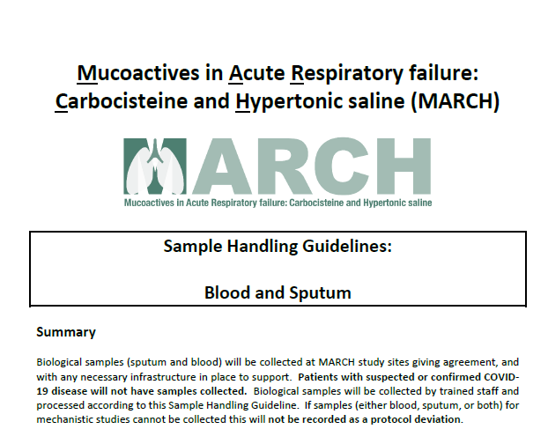
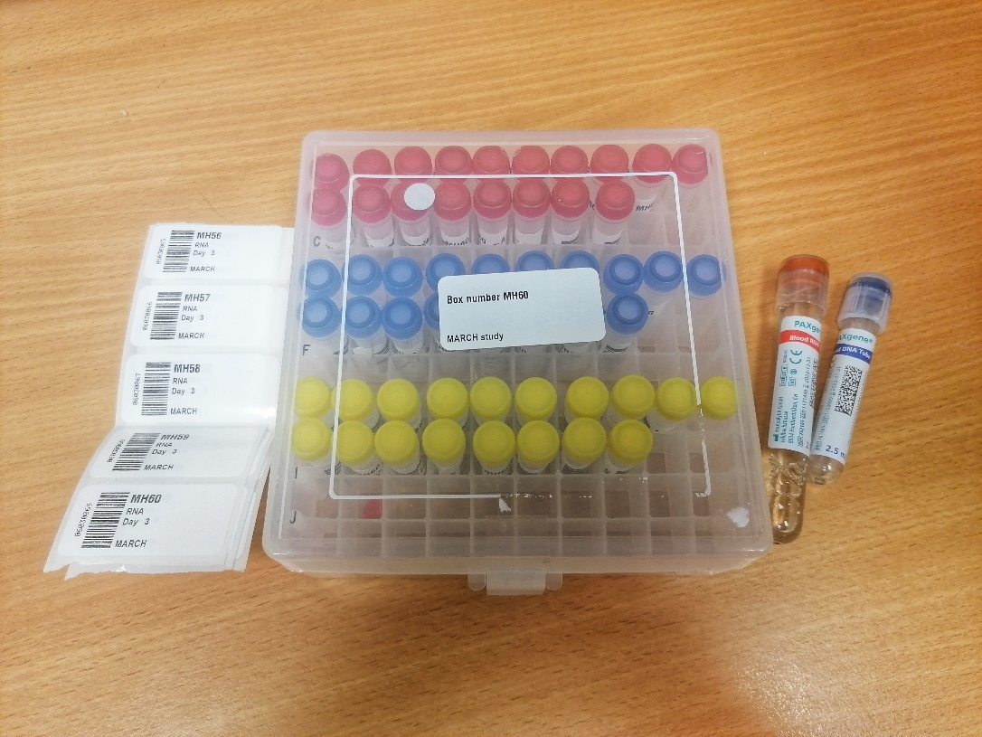
Sample Study

Slide 32
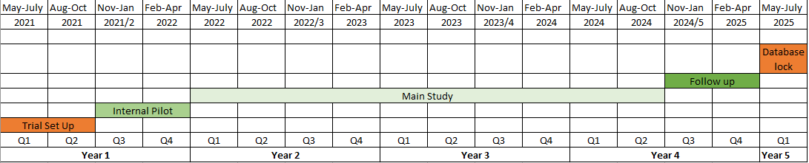
MARCH Study Timeline and Key Milestones
31st Jan 2022;
Further 15 sites open
30th Oct 2024;
1956 patients recruited
1st Nov 2021
Open for recruitment; 15 sites open
30th April 2022; 40 sites open
Green light
152 - 203 patients recruited
by 30th April 2022

Slide 33
Internal Pilot (6 months: Nov 21 – April 22)
NIHR RECRUITMENT Progression Criteria
Red Amber Green
 | RED | AMBER | GREEN
% Threshold | <40 | 40-74 | 75-100
Recruitment rate/site/month | <0.6 | 0.6-<1.1 | 1.1-1.5
No. of Sites Open | <12 | 12-22 | 23-30
Total no. of participants recruited | <81 | 81-151 | 152-203

Slide 34
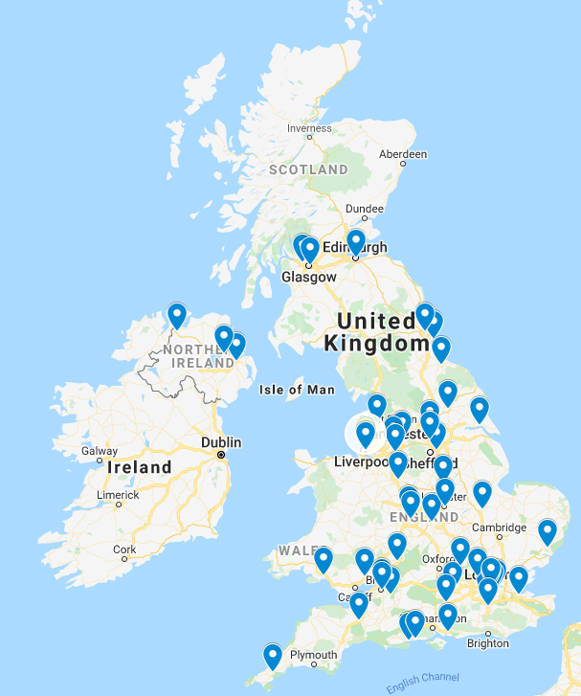
MARCH Study Sites
52 (and counting!) ICUs across all 4 nations
Variation in ICU size and speciality
Phased opening
  30 sites for inclusion in the pilot study
NIHR funding for translation of patient- and family-facing materials
  Thank you for responses so far to assist

Slide 35
Mucoactive Management and Pharmacovigilance

Slide 36
MARCH - Type A CTIMP Study (Protocol V1.0)
MHRA Clinical Trial Authorisation (CTA) under the notification scheme for Type A CTIMPs
  Risks are no higher than that of standard medical care
  Products used within licensed range of indications
  Risk adapted pragmatic approach to IMP management using routine ICU stock
Investigational Medicinal Products (IMPs) (Protocol V1.0)
  Carbocisteine capsules (375mg), or 250 mg/5ml Syrup
  Hypertonic saline 6% or 7% inhalation solution
Reference safety information
  Carbocisteine - Section 4.8 of SPC for Mucodyne 375mg capsules (date 18/03/2021)
  Hypertonic saline – Side effects as listed in Mucoclear 6% inhalation solution Product Instructions for Use Leaflet or PIL (as of 31/07/2018)

Slide 37
MARCH - Type A CTIMP Study (Protocol V1.0)
MHRA Clinical Trial Authorisation (CTA) under the notification scheme for Type A CTIMPs
  Risks are no higher than that of standard medical care
  Products used within licensed range of indications
  Risk adapted pragmatic approach to IMP management using routine ICU stock
Investigational Medicinal Products (IMPs) (Protocol V1.0)
  Carbocisteine capsules (375mg), or 250 mg/5ml Syrup
  Hypertonic saline 6% or 7% inhalation solution
Reference safety information
  Carbocisteine - Section 4.8 of SPC for Mucodyne 375mg capsules (date 18/03/2021)
  Hypertonic saline – Side effects as listed in Mucoclear 6% inhalation solution Product Instructions for Use Leaflet or PIL (as of 31/07/2018)
NB Protocol V2.0 includes use of Carbocisteine Sachets

Slide 38
MARCH - Type A CTIMP Study (Protocol 2.0)
MHRA Clinical Trial Authorisation (CTA) under the notification scheme for Type A CTIMPs
  Risks are no higher than that of standard medical care
  Products used within licensed range of indications
  Risk adapted pragmatic approach to IMP management using routine ICU stock
Investigational Medicinal Products (IMPs)
  Carbocisteine capsules (375mg), or 250 mg/5ml Syrup or
  Hypertonic saline 6% or 7% inhalation solution
Reference safety information
  Carbocisteine - Section 4.8 of SPC for Mucodyne 375mg capsules (date 18/03/2021)
  Hypertonic saline – Side effects as listed in Mucoclear 6% inhalation solution Product Instructions for Use Leaflet or PIL (as of 31/07/2018)

Slide 39
Study Mucoactive Administration (1)
Products will be used within terms of marketing authorisation/ established clinical practice
Used from local site stock and usual site practice will be followed for the purchase, supply and administration
Prescribed and dispensed in accordance with usual local site prescription practice
  No additional labelling outside usual local records or practice
Batch traceability and product recall processes will match standard hospital medicines management processes for licensed medicines

Slide 40
Study Mucoactive Administration (2)
Patient enrolment and treatment allocation recorded in clinical notes
Source document for IMP administration will be the inpatient medication administration record
First dose of study mucoactive will be administered as soon as possible, ideally within 4 hours of randomisation
  Not protocol deviation
Subsequent doses given as per locally determined scheduled prescription
  If a dose is not administered at the intended time, it may be administered subsequently but not within 1 hour of the next intended dose

Slide 41
Study Mucoactive Administration (3)
Intended duration of treatment with study mucoactives will be up to and including Day 28 (or the primary outcome is reached), or ICU discharge, or death, whichever comes first
Patients should receive study mucoactives for 48 hours post extubation until the primary outcome of duration of mechanical ventilation (first successful unassisted breathing) is reached

Slide 42
Study Mucoactive Administration (4)
NB Where extubation occurs on Day 27 or Day 28, mucoactives should continue to be administered until Day 29 or Day 30 respectively
  Daily data collection and safety outcome reporting also continues for duration of study drug administration (until Day 29 or Day 30 for patients extubated on Day 27 or Day 28)
A patient achieving their first successful unassisted breathing (which marks the primary outcome of duration of mechanical ventilation) will have completed their intervention period in the trial. Continuation of any study mucoactive after this point will be at the discretion of the treating clinical team

Slide 43
Study Mucoactive Termination
Study mucoactives (carbocisteine, or hypertonic saline, or both) will be continued until the first of the following:
1. 28 days elapse since randomisation
2. First successful unassisted breathing
3. Study mucoactive-related serious adverse event
4. Discharge from ICU
5. Death or discontinuation of active medical treatment
6. Request from Legal Representative or patient to withdraw from the trial
7. Decision from the attending ICU physician that the study mucoactive should be discontinued on safety grounds.
The reason for discontinuation of treatment should be recorded on the CRF

Slide 44
Study Mucoactive Compliance
Nursing staff at the site will administer the study mucoactives
The administration or omission of study mucoactives will be recorded in the case report form (CRF) (not a protocol deviation)
Adherence to usual airway clearance management will be monitored throughout the study
  TMG will review sites that administer carbocisteine or hypertonic saline to participants randomised to usual airway clearance management group
Administration of non-trial mucoactives will be recorded on the CRF (not a protocol deviation)

Slide 45
Pharmacovigilance (1)
MARCH population may naturally experience Adverse Events (AE) and Serious Adverse Events (SAE)
Events that are expected in this population do not need to be reported as AEs
  E.g. death, agitation, delirium, organ failure, nosocomial infections
Events that are collected as safety outcomes for MARCH do not need to be reported as AEs
  Clinically important upper GI bleeding; bronchoconstriction; ventilator or circuit dysfunction with clinical deterioration; hypoxaemia during nebulisation

Slide 46
Pharmacovigilance (2)
Only SAEs that are related to the mucoactive should be reported i.e. Serious Adverse Reactions (SAR)
SAE defined as related to the mucoactive if assessed as being possibly, probably, or definitely related to the mucoactive
All SARs should be reported to the CTU within 24 hours of the investigator becoming aware of the event
Reporting period for the trial begins upon administration of the mucoactive and ends at ICU discharge, death or Day 28 - whichever occurs first (or up to Day 29 or Day 30 for patients extubated Day 27 or Day 28 respectively)

Slide 47
Pharmacovigilance (3)
Suspected Unexpected Serious Adverse Reactions (SUSARs) are SAEs that are considered to be related to the mucoactive and are unexpected i.e. their nature or severity is not consistent with the reference safety information
CTU is responsible for reporting SUSARs to the Sponsor, REC, and MHRA within the required timelines:
  Fatal or life-threatening: within 7 days of CTU’s first knowledge of the event; follow-up information will be provided within an additional 8 days
  All other SUSARs: reported to MHRA and REC within 15 days of knowledge of such an event

Slide 48
Pharmacy: Next Steps
Pharmacy file to follow shortly and to be updated by site staff
  Index
  Contact Details – for NICTU, CI and Co-CI
  Protocol
  SIV Presentation Slides
  Reference Safety Information for Mucodyne Capsules and Hypertonic saline 6%
  LIP Covering Letter
  Risk Adaptions Document
  Pharmacy Technical Review
Pharmacy staff – GCP training, CV, protocol training, sign delegation log

Slide 49
Any questions?

Slide 50

Discussion Point:
How will your site/team identify potentially eligible MARCH patients?
Inclusion criteria: Presence of secretions that are difficult to clear with usual airway clearance management (as assessed by the treating clinical team)
MARCH Site Initiation Visit Slides V5.0 02/12/2021

Slide 51
Local Study Management

Slide 52
Screening and Recruitment Log
Screening
All mechanically ventilated patients in the ICU screened daily for MARCH eligibility
  Patients who meet inclusion criteria entered onto screening log eCRF (MACRO) (MS Excel provided for site use)
  Screening number SXXYYYY (XX-Centre no., Y - 0001, 0002 generated on eCRF)
Reasons patient is not recruited will be recorded on log
  For CONSORT reporting
  Recruitment monitoring and optimisation
  Return eCRF MACRO Screening and Recruitment Log to NICTU by 1st Friday of every month (MS Excel for local site use only)
Notes:
We would ask all sites to keep an up to date screening and recruitment log. All mechanically ventilated patients in the ICU with ARF should be screened daily for MARCH eligibility.
Patients who meet the inclusion criteria should be entered onto the screening log eCRF. We also provide sites with a MS Excel version of the screening log, for local data capture.
Each patient will be given a screening number. The first two digits are the centre number and the next come in numerical order.
We want to record the reasons patients are not recruited onto the screening log. This is for two reasons. To meet CONSORT reporting guidelines, when we come to publish the trial’s results, and to monitor and optimise recruitment. So we will be closely analysing the data you enter and return on the screening and recruitment log at our monthly TMG meetings. We ask all sites to return the completed eCRF on the 1st Friday of every month, so we know how recruitment is going at your site and to the trial overall. So it is really important to keep the screening log up to date.

Slide 53
Screening Log eCRF: The SEAR Framework
Screening: for all patients who meet the MARCH inclusion criteria
Aged ≥16 years
An acute and potentially reversible cause of ARF as determined by the treating physician
Receiving invasive mechanical ventilation via endotracheal tube or tracheostomy
Anticipated to remain on invasive mechanical ventilation for at least 48 hours
Presence of secretions that are difficult to clear with usual airway clearance management (as assessed by the treating clinical team)
Notes:
You may notice a few more questions than usual on the MARCH screening log and that is because we want to know in a little bit more depth what has happened to patients who are screened for MARCH and the reasons why they were excluded.
To do this we are using the SEAR framework, which I developed with colleagues at Bristol University, so that we can understand what happens to patients along the pathway – at each stage of the recruitment process – S stands for Screened; E stands for eligible, A stands for approached; R stands for randomised? The proportion of eligible patients who are randomised into a study can often vary considerably across different hospitals for the same trial, so we want to monitor this to understand if there are any ways in which we can improve trial recruitment.
We ask sites to record all patients who meet the MARCH inclusion criteria to be entered onto the screening log, in particular those who have secretions that are difficult to clear with usual airway clearance management as assessed by the treating clinical team.

Slide 54
Screening Log eCRF: The SEAR Framework
Eligibility: record eligible/ ineligible against criteria
8. Provide physician reason (Open text e.g. active peptic ulceration, COVID-19, asthma)
Pre-existing chronic respiratory condition receiving routine use of any mucoactive
Mucoactive treatment started more than 24 hours prior to trial enrolment
Known adverse reaction to either study mucoactive
Treatment withdrawal expected within 24 hours
Known pregnancy
Previous enrolment in the MARCH trial
Prisoners
The treating physician believes that participation in the trial would not be in the best interests of the patient
Notes:
The next stage is to record the eligibility of patients on the screening log. There are 8 reasons for ineligibility on the screening log. Where the treating physician believes that participation in the trial would not be in the best interests of the patient, we would ask you to record the reason as an open text field on the screening log.

Slide 55
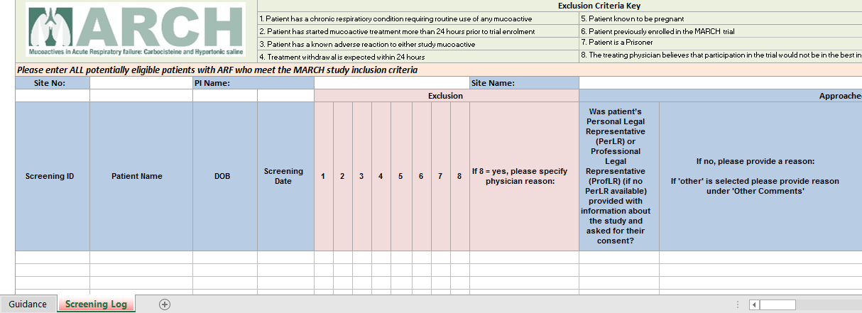
Screening Log eCRF: The SEAR Framework
Notes:
Here is a screenshot of the log in MS Excel. The exclusion criteria are listed at the top as a guide and there is a guidance on the tab to help fill out the log. So hopefully it should be self-explanatory, but if you have any queries, please get in touch.

Slide 56
Screening Log eCRF: The SEAR Framework
Approach
Was patient’s Personal Legal Representative (PerLR) or Professional Legal Representative (ProfLR) (if no PerLR available) provided with information about the study and asked for their consent?
  If no, provide the reason (drop down and open text in ‘Other comments’)
Randomised?
If yes, was consent obtained?
  If no, provide the reason (drop down and open text for in ‘Other comments’)
Other Comments - open text on non-recruitment and other feedback
Non-English language PIS required - Please specify
Notes:
For Approach, we ask you to record whether the patient’s personal or Prof legal representative was provided with information and asked for their consent. If this didn’t happen for whatever reason, we have provided some answers which you can select on the screening log, and if these are not covered, we ask you to provide further information why the patient’s LR was not given information in the other comments box.
We are also interested to capture the reasons why a patient’s LR may decline to take part in a study, so we would ask you to record this in the other comments box.
If you have any other comments about the screening and recruitment of a particular patient, please note this on the screening log. We also have included a question about language, so that we can provide information sheets for patients and their LR to make sure the trial is offered to all eligible participants.

Slide 57
Eligibility Confirmation
Before randomisation
Eligibility must be confirmed by a medically qualified person on the delegation log and signed off in patient’s medical notes (stickers provided which include the date and time)
Eligibility checklist completed in eCRF (MACRO)
Pregnancy test for all women (urine pregnancy test in females with child-bearing potential (aged 15-55 years))
Reasons for ineligibility on eCRF Screening and Recruitment log (MACRO)
Notes:
The medic confirming eligibility will need to document the date/time that the patient was eligible in the medical notes.
Sites just need to ensure this is documented. When this actually physically takes place will be down to the sites.
If they have access to medical notes remotely then this can be done remotely.
They can document it in the medical notes directly, else we will also provide stickers to aid them documenting this in the medical notes.
This shouldn’t hold up a site randomising the patient. So long as they have confirmed eligibility and got consent they can proceed.
It is our understanding sites usually just document this in the notes automatically. Very few use remote systems.

Slide 58
Informed Consent Process (1)
The Legal Representative (LR) of all patients who meet the inclusion and exclusion criteria for MARCH should be provided with information and consent form:
  Translated information and consent forms available
  Record reason for non-approach on eCRF screening and recruitment log
Consent sought from a Personal Legal Representative (PerLR) or Professional Legal Representative (Prof LR) (if PerLR not available)
  If consent not given, record the reason on eCRF

Slide 59
Informed Consent Process (2)
Personal Legal Representative (PerLR) is defined as a person who is not connected with the conduct of the trial who is suitable to act as the legal representative by virtue of their relationship with the patient, and is available and willing to do so (HRA 2020)
  Relative/ friend/ partner
The PerLR will be informed about the trial by the responsible clinician/ research team and provided with a copy of the PerLR covering statement, PerLR information sheet (PIS) and consent form
The PerLR will be asked to give an opinion as to whether the patient would be willing to participate in such medical research

Slide 60
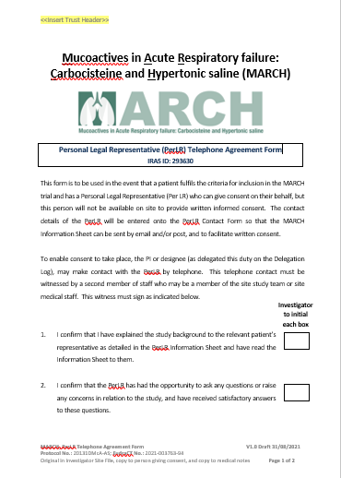
Informed Consent Process (3)
Telephone Consent for PerLR
  Researcher may contact PerLR by telephone
  Verbal agreement recorded on form
  Signed by a second member of staff who witnessed the phone call
  Written consent subsequently obtained if possible
  Form filed in ISF and medical notes
MARCH Site Initiation Visit Slides V5.0 02/12/2021

Slide 61
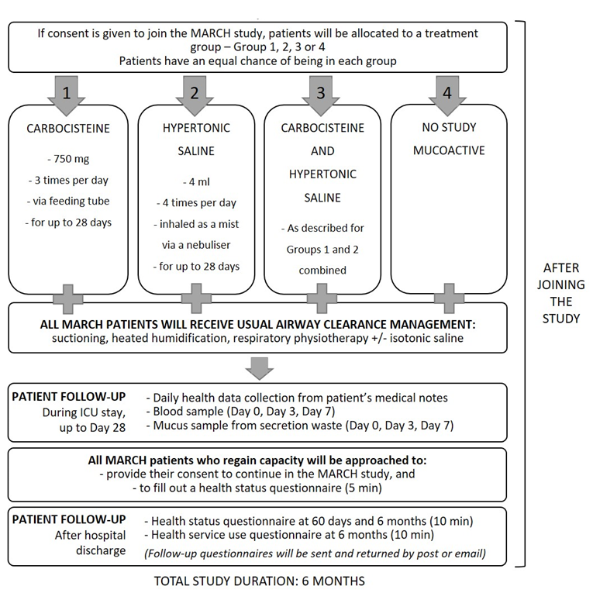
Patient Pathway Diagram in
Information Sheet to facilitate
informed consent discussions
Recommended by Patient and Family Advisory Group to support consent process

Slide 62

Informed Consent Process (4)
Professional Legal Representative
If no PerLR available in person or by telephone
The ProfLR is defined as a doctor responsible for the medical treatment of the patient if they are independent of the study, or a person nominated by the healthcare provider
  If consent not given, record the reason on the eCRF
MARCH Site Initiation Visit Slides V5.0 02/12/2021

Slide 63
Informed Consent Process (5)
Must be obtained from the patient’s LR prior to conducting any trial specific procedures
The informed consent form (ICF) must be signed and dated by the patient’s LR and the study staff taking consent
Original ICF:
  To be retained in the Investigator Site File
Copy of Information Sheet & ICF:
  To be filed in the patient’s medical notes
  To be given to the LR
GP Letter to be sent for enrolled patients

Slide 64
Randomisation System
CHaRT Randomisation System (University of Aberdeen)
Telephone and web-based systems (24/7)
Eligible participants will be allocated to one of four treatment groups in a 1:1:1:1 ratio
Randomisation stratified by recruitment centre
Ensure internet browser is enabled for Internet Explorer v8 or above
Randomisation notifications with treatment allocation sent to staff as per user requests
User accounts, guide and training support provided by NICTU

Slide 65

https://w3.abdn.ac.uk/hsru/MARCH/Login/login.aspx

Slide 66
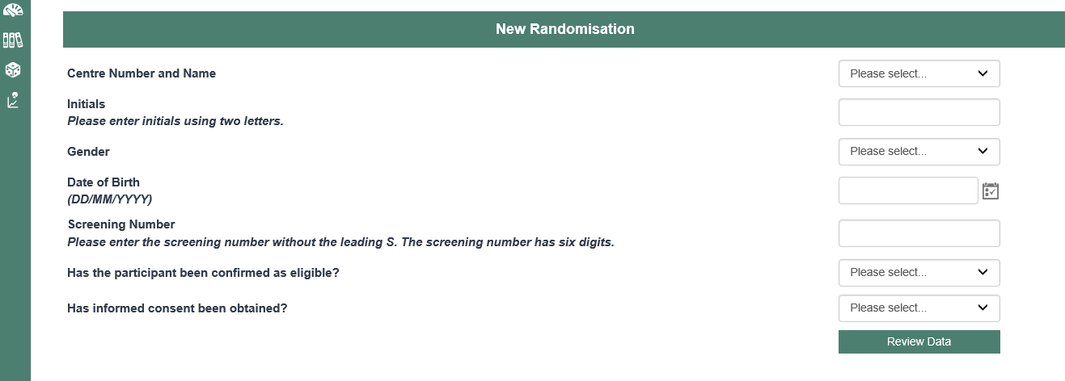

Slide 67
Trial Data Collection eCRF (MACRO)

Slide 68
eCRF (MACRO) for Trial Data Collection
MACRO user ID and training for all staff using the database
  Training sessions provided by Data Manger (Una Holmes)
  Previous MACRO training provided by NICTU counts for MARCH
Please log into MACRO soon after randomisation as possible to enter patient details and baseline data
  No later than Day 7
  Daily data collection - respiratory physiotherapy for usual airway clearance management (all groups), study mucoactives administration, non-study mucoactives administration, antibiotic usage

Slide 69
Data Collection (Day 0)
Day 0 (Baseline) – Baseline data are collected in the 24 hours preceding randomization (Day 0)
If more than one value is available for this 24 hour period the value closest but prior to the time of randomization will be recorded
Demographic, clinical, data linkage/identifiers, trial process data
  See protocol for details
Please be prompt with data entry

Slide 70
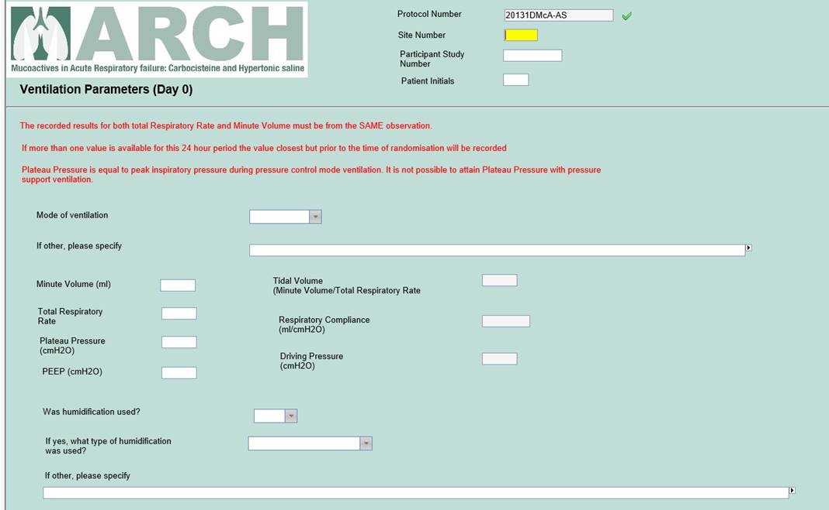

Slide 71
Daily Data Collection (Day 1 to Day 28) (1)
Day 1 is from the time of randomisation to the end of that calendar day
  Day 1 will be less than 24 hours’ duration
If more than one value is available for this period, the value closest to but after the time of randomisation will be recorded
All other daily measurements will be recorded between 6am and 10am (or as close to this time as possible) on subsequent days, unless otherwise stated in the CRF
Daily data will be collected up to and including Day 28 (or up to 29 or 30 days for patients extubated on Day 27 or Day 28 respectively), or until the primary outcome is reached, or ICU discharge, or death

Slide 72
Daily Data Collection (Day 1 to Day 28) (2)
Respiratory physiotherapy airway clearance management
Administration of any non-trial mucoactive
Study mucoactive administration
Antibiotic usage
Study mucoactive-related serious adverse event
Safety outcomes

Slide 73
Other Data Collection (ICU/ hospital)
Event-driven data recorded as/when occurring throughout the ICU and hospital stay:
  Date and time of discontinuation of mechanical ventilation (to determine duration of mechanical ventilation)
  Date and time of extubation
  Date and time of re-intubation
  Date and time of ICU discharge
  Date and time of hospital discharge
  Date and time of death

Slide 74
Follow-up Data Collection

Slide 75
Consent to Continue (1)
Consent to continue will be sought after patient regains capacity
  If patient does not give consent, permission to use data collected to that point will be requested
If consent to continue is not obtained, the legal representatives’ consent remains valid.
  Patient will be sent follow-up questionnaires - EQ-5D-5L and health services use questionnaire
  Patient cannot participate in the SWAT

Slide 76
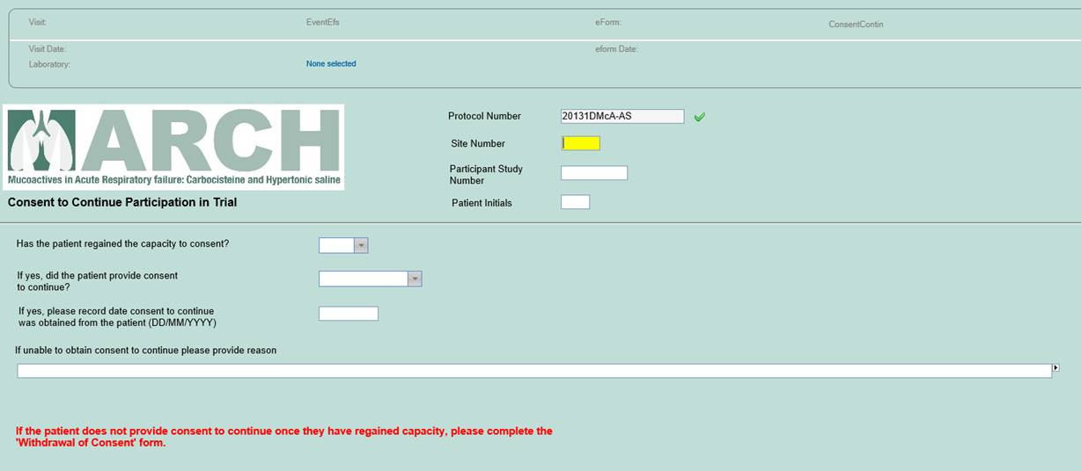
Consent to Continue (2)
Notes:
If the patient has regained capacity, they should be followed up outside ICU, so they can be approached for consent to continue. This is really important they are provided with the opportunity to give consent for themselves to take part in the study. It also means they can participate in the SWAT. If a patient provides consent to continue, that is great – the date can be entered. If the patient does not provide consent to continue (ie they do not wish to take part in the research), they should be followed up with a withdrawal of consent form which is contained within the CRF – this form records the parts of the study which the patient with draws from ( which I will come onto shortly).
If you are unable to obtain consent to continue, for example because the patient has been discharged, please note the reason for this. These patients are still in the study and will be followed up by NICTU – they just won’t be part of the SWAT, and the Legal Representative’s consent remains valid.

Slide 77
Consent to Continue (3)
Ask patients to fill out an EQ-5D-5L
Give patients a health service use diary and explain this is for patients to note health service use for 6 months following hospital discharge
If consent to continue is obtained patients can be entered into the SWAT; to be eligible for the SWAT:
  Consent to continue
  Date of hospital discharge
  Follow-up by NICTU

Slide 78

Time-critical data entry for SWAT
If randomised, SWAT patients will receive a ‘thank you card’ and gift item 2 weeks following hospital discharge if information on eCRF:
  Consent to continue
  Date of hospital discharge (on average 2 weeks from ICU charge)
Please follow-up MARCH patients post-ICU discharge, to assist data collection for study duration (6 months)

Slide 79
Study Withdrawal (eCRF form)
If patient or Legal Representative asks to withdraw consent, the researcher will determine which elements of the trial are to be withdrawn including:
  Mucoative administration (if ongoing)
  Data collection during hospital admission/ following hospital discharge
  Confirmation of vital status
  Use of samples/ data collected to date
In event of withdrawal of consent anonymised data until point of withdrawal will be included unless explicitly stated otherwise (likewise samples)

Slide 80
Recording and Reporting of Adverse Events (TM03)
Notes:
TM03 is an NICTU SOP which we use in our trials to record and report adverse events. Those on the delegation log who are tasked with recording and reporting Aes should be trained via reading and understanding on the SOP.

Slide 81
Recording and Reporting of Adverse Events TM03 (1)
It is expected that many of the participants will experience adverse events (AEs) and serious adverse events (SAEs)
Events that are expected in this population do not need to be reported as adverse events (AEs). E.g. death, agitation, delirium, organ failure and nosocomial infections
Events that are collected as safety outcomes for the MARCH study do not need to be reported as AEs, including clinically important upper GI bleeding, bronchoconstriction, ventilator or circuit dysfunction with clinical deterioration, and hypoxaemia during nebulisation

Slide 82
Recording and Reporting of Adverse Events TM03 (2)
Responsibility for recording and reporting of AEs/SAEs/SARs/SUSARs – PI or medically qualified designee on delegation log
Assessed for seriousness, causality, severity and expectedness
  Protocol
  Reference safety information
    Carbocisteine - Section 4.8 of SPC for Mucodyne 375mg capsules (date 18/03/2021)
    Hypertonic saline – Side effects as listed in Mucoclear 6% inhalation solution Product Instructions for Use Leaflet or PIL (as of 31/07/2018)
  SOP TM03 – recording and reporting AEs

Slide 83
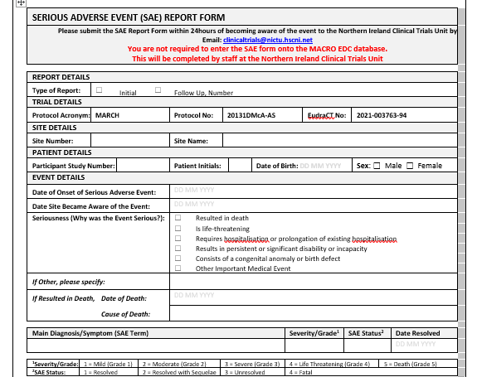
Recording and Reporting of Adverse Events TM03 (3)
Only SAEs related to the mucoactive should be reported
  Serious Adverse Reaction (SAR)
Use SAE Reporting Form
SAE will be defined as related to the mucoactive if assessed as being possibly, probably or definitely related to the mucoactive
MARCH Site Initiation Visit Slides V5.0 02/12/2021

Slide 84
Recording and Reporting of Adverse Events TM03 (4)
The PI or designee should make an assessment of causality, i.e. the extent to which it is believed that the event may be related to the mucoactive:
Category | Definition
Definitely* | Temporal relationship of the onset, relative to administration of the product, is reasonable and there is no other cause to explain the event, or a re-challenge (if feasible) is possible
Probably* | Temporal relationship of the onset of the event, relative to the administration of the product, is reasonable and the event is more likely explained by the product than any other cause.
Possibly* | Temporal relationship of the onset of the event, relative to administration of the product, is reasonable but the event could have been due to another, equally likely cause.
Unlikely | Temporal relationship of the onset of the event, relative to administration of the product, is likely to have another cause which can by itself explain the occurrence of the event. Not Related
Not related | Temporal relationship of the onset of the event, relative to administration of the product, is not reasonable or another cause can by itself explain the occurrence of the event
* Where an event is assessed as possibly, probably or definitely related, the event is an AR.

Slide 85
Recording and Reporting of Adverse Events TM03 (5)
The PI or designee should make an assessment of severity according to the following categories:
Category | Definition
Mild (Grade 1) | A reaction that is easily tolerated by the trial participant, causing minimal discomfort and not interfering with every day activities.
Moderate (Grade 2) | A reaction that is sufficiently discomforting to interfere with normal everyday activities
Severe (Grade 3) | A reaction that prevents normal everyday activities
Life Threatening (Grade 4) | A reaction that has life threatening consequences; urgent intervention indicated
Death (Grade 5) | A reaction that results in death

Slide 86
Recording and Reporting of Adverse Events TM03 (6)
PI or designee should make an assessment of the seriousness on the basis that it:
  Resulted in death
  Is life-threatening
  Requires hospitalisation or prolongation of existing hospitalisation
  Results in persistent or significant disability or incapacity
  Consists of a congenital anomaly or birth defect
  Is any other important medical event(s) that carries a real, not hypothetical, risk of one of the outcomes above.
PI or designee is required to make an assessment of the expectedness if the event is possibly, probably or definitely related to the mucoactive

Slide 87
Recording and Reporting of Adverse Events TM03 (7)
All SARs must be reported in the patient’s medical notes
SARs to be captured by site staff on the eCRF AE form
SARs to be recorded on the paper SAE reporting form, signed by PI or medical designee, and submitted electronically to clinicaltrials@nictu.hscni.net, within 24 hours of becoming aware of the SAE
NICTU will confirm receipt by e-mail and retain all documentation of SAEs and correspondence

Slide 88
Urgent Safety Measures (TM03)
Recording and Reporting urgent safety measures
  Information necessitating an immediate change to study procedures to protect participants from immediate harm – contact MHRA safety scientist 020 3080 6465
  PI should also contact NICTU within 24 hours by email – clinicaltrials@nictu.hscni.net
  The PI or designee should respond to queries from the Sponsor or Chief Investigator immediately to ensure the adherence to reporting requirements to REC and MHRA
  Reference Section 16 of MARCH Protocol: Pharmacovigilance

Slide 89
Protocol Deviations/ Serious Breaches
What is a deviation?
An incident which deviates from the normal expectation of a particular part of the trial process is considered a deviation.
If a deviation from the protocol or GCP occurs during a trial, the PI must be notified, and it must be recorded on the ‘Protocol Deviation Log’
What is a serious breach?
A serious breach is a deviation from the trial protocol or GCP which is likely to effect to a significant degree:
  the safety or physical or mental integrity of the subjects of the trial,
  or
  the scientific value of the trial
Notes:
An incident which deviates from the normal expectation of a particular part of the trial process is considered a deviation. Deviations from clinical trial protocols and Good Clinical Practice (GCP) occur commonly in clinical trials. The majority of these are technical deviations that do not result in harm to trial patients or significantly affect the scientific value of the reported results of the trial.
What is a Serious Breach?
A serious breach is a deviation from the trial protocol or GCP which is likely to effect to a significant degree:
(a) the safety or physical or mental integrity of the subjects of the trial; or
(b) the scientific value of the trial
Recording and Reporting of Protocol or GCP Deviations
Protocol or GCP deviations that occur at a site , that are patient specific, should be documented using the Protocol Deviation Form within the electronic case report form (eCRF) and recorded on the clinical trial database.
Protocol or GCP deviations documented within the eCRF, should be submitted to the CTU within 28 days of becoming aware of the event.
Protocol or GCP deviations that occur at a site, that are non patient specific (e.g. protocol or GCP training has not been completed), should be documented at site using the Protocol Deviation Form within the Investigator Site File (ISF).
Protocol or GCP deviations documented on a Protocol Deviation Form, should be submitted to the CTU within 28 days of becoming aware of the protocol or GCP deviation, by email to MARCH@nictu.hscni.net
Recording and Reporting of a Serious Breach
A potential serious breach, should be documented by the site using the Notification of Serious Breach Form within the ISF.
A potential serious breach documented on a Notification of Serious Breach Form, should be submitted to the CTU within 24 hours of becoming aware of the potential serious breach, by email to clinicaltrials@nictu.hscni.net

Slide 90
Recording and Reporting of Protocol or GCP Deviations
Protocol or GCP deviations that occur at a site, that are patient specific, should be documented using the Protocol Deviation Form within the eCRF and recorded on the clinical trial database
Protocol or GCP deviations that occur at a site, that are non-patient specific, should be documented at site using the Protocol Deviation Form within the Investigator Site File (ISF)
Submitted to the CTU within 28 days of becoming aware to MARCH@nictu.hscni.net

Slide 91
Protocol Deviations/ Serious Breaches
If the deviation is classified as a potential ‘serious breach’, the PI should complete a ‘Notification of Serious Breach of Trial Protocol or GCP’ form
  Contact the CI or Co-CI to discuss a potential serious breach
  The PI should scan and email the form to the NICTU within 24hrs of becoming aware of the breach
The Sponsor along with the trial management team will investigate reports of potential serious breaches and fully document any action taken

Slide 92
Investigator Site File (ISF)
Trial Master File (TMF) holds all essential documents
Inspections or Audits of the TMF are used confirm compliance with regulatory requirements
The Investigator Site File (ISF) at each site is a key section of the TMF
NICTU has been delegated TMF set-up & maintenance by the Sponsor, therefore, the ISF must be set-up according to NICTU SOP TM02: ISF and Essential Documents
PI is ultimately responsible for the set up and maintenance of all essential documents in the ISF but may delegate (Task 17) to a member of the research team who has documented SOP training

Slide 93
Investigator Site File SOP TM02
Each site will be provided with an ISF following initiation
NICTU staff will assist site staff in the setting up the ISF
Each ISF has an index of essential documents
Some essential documents may be located in other areas e.g. Pharmacy
  Add a file note to explain where the document can be located
ISF should be held in a secure location with restricted access
  In a locked, fireproof filing cabinet
This will be checked at monitoring/audit visits

Slide 94
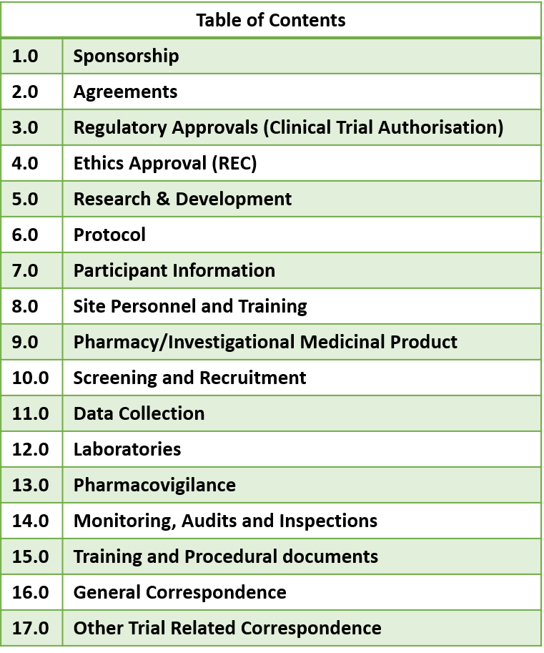
ISF Index
Index at the beginning of the file outlines the documents to be retained in the file and where these should be held
Intended as a guide; if a document is not applicable to the MARCH trial this should be noted on the index

Slide 95
Investigator Site File (ISF)
Maintained and kept up to date on an on-going basis throughout the trial
  All documents should legible and accurate and signed and date as appropriate
  Previous versions of essential documents i.e. protocol should be marked as superseded
  All filing done in a timely manner and filed chronologically within each section
  Must be available for monitoring visits for audits
Once the trial is finished the PI is responsible for reviewing to ensure all essential documents are present
  Once close out activities completed the ISF can be archived, when advised by NICTU
  PI is responsible for archiving essential documents at the study site
  Sites follow local R&D SOP for archiving
  Change of PI – R&D office/PI need to notify NICTU

Slide 96
Retention of Trial Records
Site PI:
  Will maintain all trial records in the ISF according to GCP and the applicable regulatory requirements
  Is responsible for the archiving of essential documents at their sites in accordance with applicable regulatory requirements, Sponsor and local policies
  Responsible for allowing Sponsor access to archived data and can be audited by the Sponsor on request
  If there is a change of PI during the study the site will need to advise and then an amendment will be progressed for change of PI
  Following confirmation from the Sponsor, the CTU will notify the PI when they are no longer required to maintain the files

Slide 97
Monitoring (1)
Remote monitoring will take place throughout the study
First remote monitoring will be arranged after the randomisation of the first 1-2 participants
On-site monitoring visit will take place thereafter
A remote monitoring close-out will be arranged at each site once the final participant recruited has completed all follow-up
Notes:
The rights, safety and well being of the trial participants are protected
The reported trial data is accurate, complete and verifiable from source documents
The trial is in compliance with the approved protocol, GCP and applicable regulatory requirements

Slide 98
Monitoring (2)
Monitoring visits will involve:
Review of the Investigator Site File
Review Consent Forms and Check Eligibility
Review data entered onto the CRF and complete source data verification (SDV)
Please ensure a team member is available to deal with queries
PI should be available at the end of the visit for a feedback meeting

Slide 99
MARCH Guidelines and SOPs
Macro Electronic Data Capture User Guide
Randomisation Guideline (Telephone/ web system)
Sample Handling Guideline
Adverse Event Reporting Guideline
Key Trial Terms
Frequently Asked Questions
Recording and reporting of Adverse Events (NICTU, SOP TMO3, Version 4.0 Final, 24/03/2016 )
Investigator Site File (ISF) and Essential Documents (NICTU, SOP TM02 Version 4.0 Final, 14/11/2016).

Slide 100
Site Set Up: Next Steps
Study Logs
  Log for Protocol Training- all staff to go on delegation Log (including Pharmacy staff)
  NICTU SOP Training Logs:
    AE/SAE reporting – All staff to be delegated Task 12 on Delegation Log
    ISF – All staff to be delegated Task 17 on Delegation Log
  Delegation Log
CVs (copies of wet-ink signed and dated within 1 year) and GCP Certs - all staff to go on Delegation Log

Slide 101

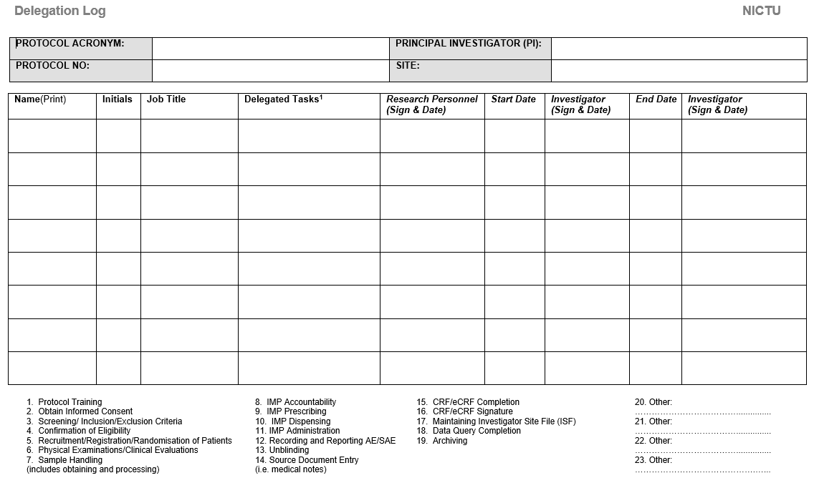
Your role in the study e.g. PI, Research Nurse, Data Manager
Date that you sign to accept the tasks assigned to you
Date that a person can start working on the study -
this must be ON/AFTER the date the PI signs (PI to complete)
Date that the PI signs to confirm that a person can start working on the study
Date that a person stops working on the study
Date that the PI signs to confirm that a person has stopped working on the study
Before you start working on MARCH you will need:
CV (scanned copy of wet ink-signed CV dated within 1 year prior to site opening)
GCP (dated within 3 years)
Training on the current Protocol
Additional training*
Fully completed Delegation Log signed & dated by the PI
Please do not fill out the Delegation Log until you have completed ALL appropriate training
CV (scanned copy of wet ink signature dated within 1 year
GCP dated within 3 years
Training on current protocol
Additional training
Fully completed delegation log signed and dated by the PI
TASK 1:
People who can train staff, new to MARCH, on the Protocol
TASK 12* :
People who can record and report SARs
Only a physician can assess expectedness & causality
Trained by:
Someone previously trained in the Recording and Reporting AEs, SAEs and Urgent Safety Measures SOP (TM03)
Recorded on:
SOP Training Log
TASK 17* :
People who can file and manage items in the ISF
Trained by:
Someone previously trained in the ISF & Essential Documents SOP (TM02)
Recorded on:
SOP Training Log
MACRO* :
TASK 15: People who can enter data
TASK 16: People who can confirm that the data entry is complete and accurate
TASK 18: People who can correct data that is already entered
Trained by:
Someone previously trained on MACRO Recorded on:
Study Training Log
TASK 4:
People who can assess eligibility i.e. a physician
If you make a mistake, put a single line through it, and initial & date it
When you update documents please send a copy to MARCH@nictu.hscni.net
MARCH Delegation Log Explanation Sheet v0.1 Draft 22/09/2021

Slide 102

Questions…

Slide 103

Thank you for attending
b.connolly@qub.ac.uk to contact Bronwen Connolly (CI)
028 9097 6047 / 07903 844833
MARCH@nictu.hscni.net to contact the MARCH Study Team
Caroline Wilson (Trial Manager),
Naomi Dickson (Trial Co-ordinator),
Cathy McMaster (Trial Administrator)
028 9615 1447

